Slide 1
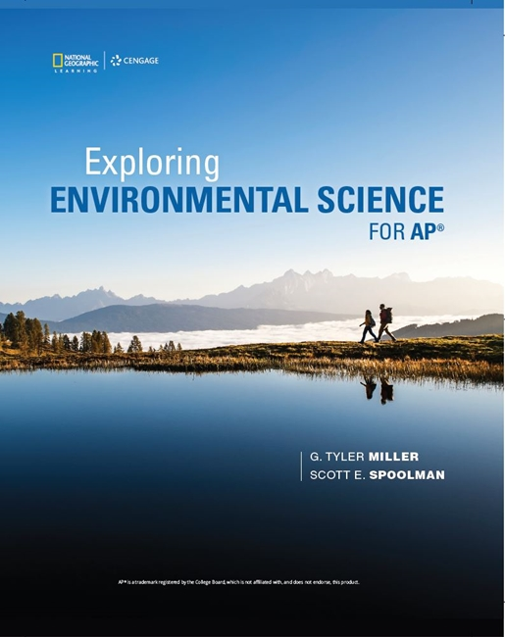
Exploring Environmental Science for AP®
1st Edition
Chapter 6
Aquatic Biodiversity
Copyright © 2018 Cengage Learning. All Rights Reserved. May not be copied, scanned, or duplicated, in whole or in part, except for use as permitted in a license distributed with a certain product or service or otherwise on a password-protected website for classroom use.

Slide 2
Core Case Study: Why Should We Care about Coral Reefs? (1 of 3)
Coral reefs among world’s oldest, most diverse, and most productive ecosystems
Form in clear, warm coastal waters in tropical areas
Tiny animals (polyps) and single-celled algae have a mutualistic relationship
Polyps secrete calcium carbonate shells, which become coral reefs

Slide 3
Core Case Study: Why Should We Care about Coral Reefs? (2 of 3)
Provide important ecological and economic services
Natural barrier to protect coastlines
Habitat, food, or spawning grounds for one-quarter to one-third of ocean’s organisms
Vulnerable to damage
Soil runoff
Climate change increasing ocean temperature
Increasing ocean acidity

Slide 4
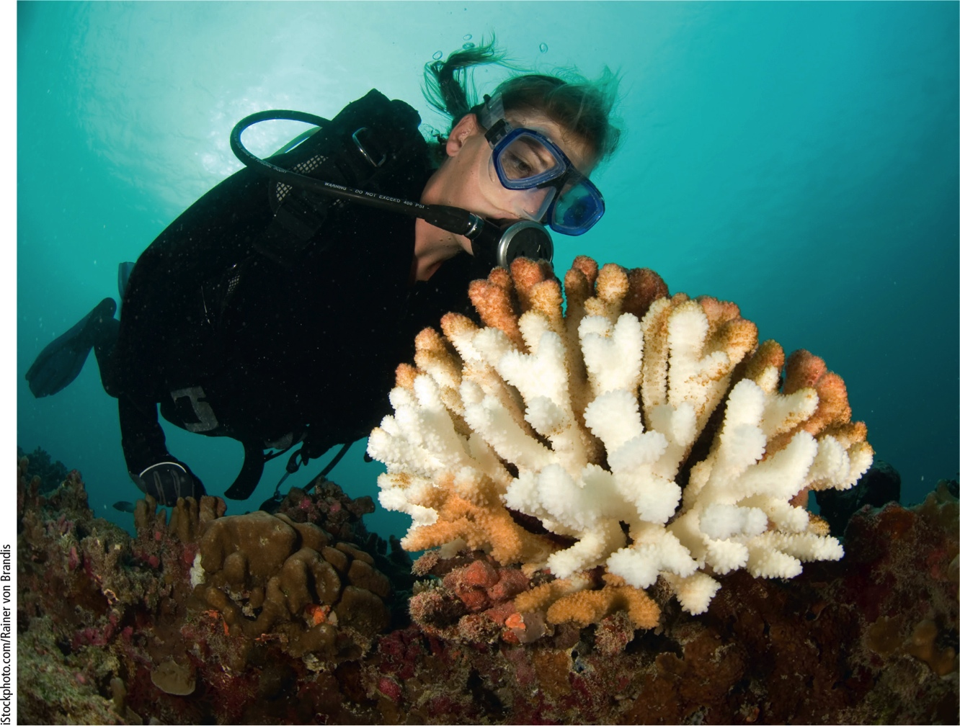
Core Case Study: Why Should We Care about Coral Reefs? (3 of 3)
Notes:
Figure 8.1 This bleached coral has lost most of its algae because of changes in the environment such as warming of the waters and deposition of sediments.

Slide 5
6.1 What Is the General Nature of Aquatic Systems?
Saltwater and freshwater aquatic life zones cover almost three-fourths of the earth’s surface
Factors determining aquatic biodiversity
Temperature
Dissolved oxygen content
Availability of food
Access to light and nutrients necessary for photosynthesis

Slide 6
Most of the Earth Is Covered with Water (1 of 2)
Saltwater covers 71% of earth’s surface
Freshwater occupies another 2%
Global ocean divided into five areas
Atlantic
Pacific
Arctic
Indian
Southern

Slide 7
Most of the Earth Is Covered with Water (2 of 2)
Distribution of organisms determined largely by salinity
Aquatic life zones
Saltwater life zones (marine life zones)
Examples: oceans, estuaries, coasts, coral reefs, and mangrove forests
Freshwater life zones
Examples: lakes, rivers, streams, and inland wetlands

Slide 8
Aquatic Species Drift, Swim, Crawl, and Cling (1 of 4)
Plankton–drifting
Phytoplankton
Primary producers for most aquatic food webs
Ultraplankton
Tiny photosynthetic bacteria
Zooplankton
Secondary consumers
Range from single-celled to large invertebrates like jellyfish

Slide 9
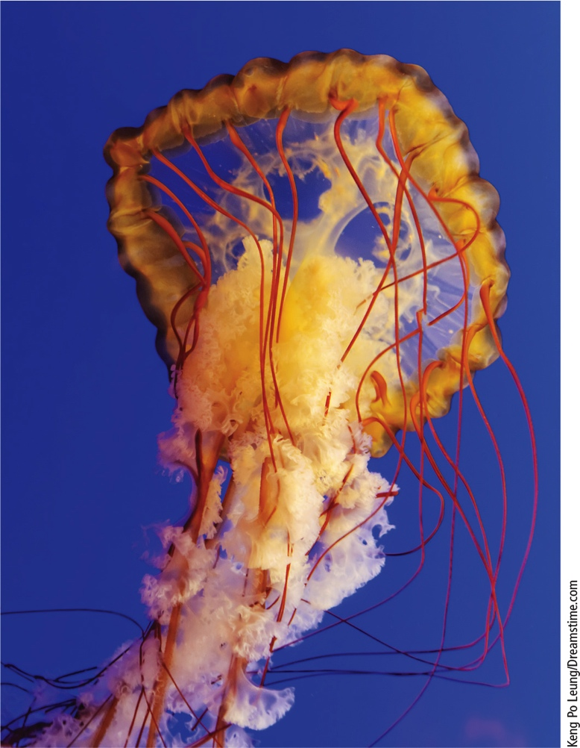
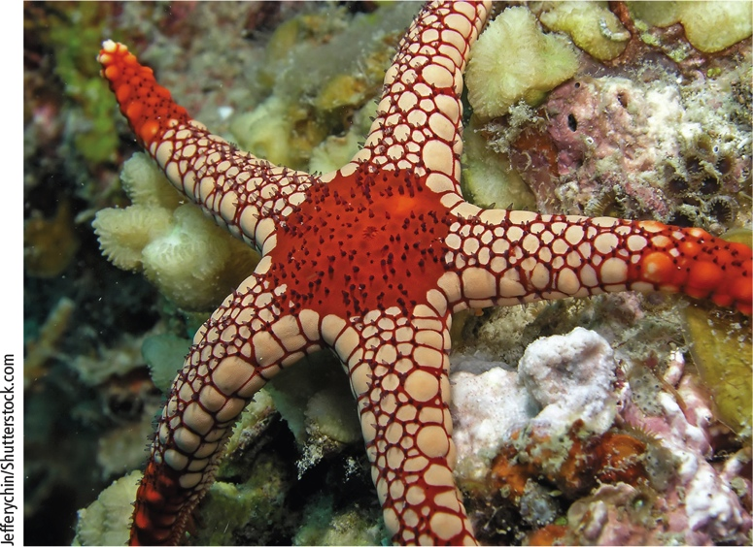
Aquatic Species Drift, Swim, Crawl, and Cling (2 of 4)
Notes:
Figure 8.2 Jellyfish are drifting zooplankton that use their long tentacles with stinging cells to stun or kill their prey.
Figure 8.3 Starfish on a coral reef. The starfish is also called a sea star because it is not a fish

Slide 10
Aquatic Species Drift, Swim, Crawl, and Cling (3 of 4)
Nekton
Strong swimmers–fish, turtles, whales
Benthos
Bottom dwellers–oysters, sea stars, clams, lobsters, crabs
Decomposers
Mostly bacteria

Slide 11
Aquatic Species Drift, Swim, Crawl, and Cling (4 of 4)
Key factors in the types and numbers of organisms
Temperature
Dissolved oxygen content
Availability of food
Availability of light and nutrients needed for photosynthesis
Turbidity
Degree of cloudiness in water

Slide 12
6.2 Why Are Marine Aquatic Systems Important?
Saltwater ecosystems
Provide major ecosystem and economic services
Irreplaceable reservoirs of biodiversity

Slide 13
Oceans Provide Vital Ecosystem and Economic Services (1 of 4)
Oceans produce more than half of oxygen we breathe
Provide most of the rain that sustains water supply
110 million tons of seafood harvested per year
The earth’s oceans are poorly understood
Potential source of ecological and economic benefits

Slide 14
Oceans Provide Vital Ecosystem and Economic Services (2 of 4)
Three major life zones
Coastal zone
Warm, nutrient rich, shallow water
Extends from land to edge of continental shelf
Makes up less than 10% of world’s ocean area
Contains 90% of all marine species
Open sea
Ocean bottom

Slide 15
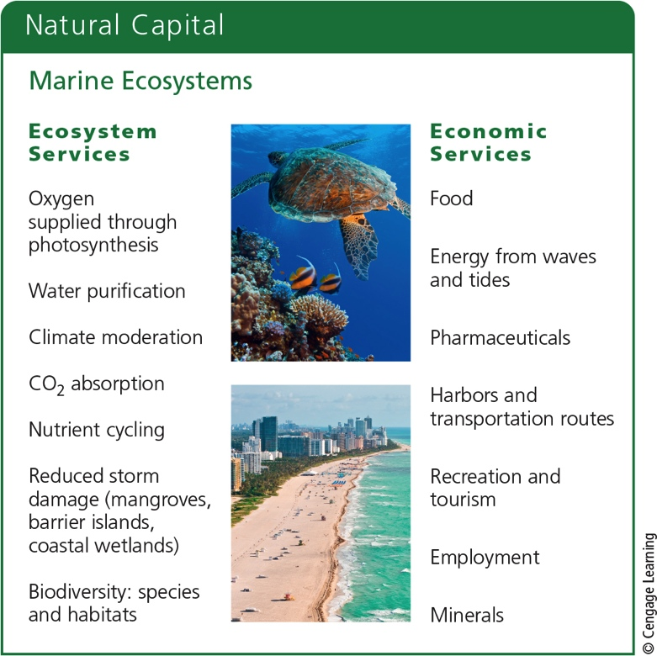
Oceans Provide Vital Ecosystem and Economic Services (3 of 4)
Notes:
Figure 8.4 Marine systems provide a number of important ecological and economic services (concept 8.2). Critical thinking: Which two ecological services and which two economic services do you think are the most important? Why?

Slide 16
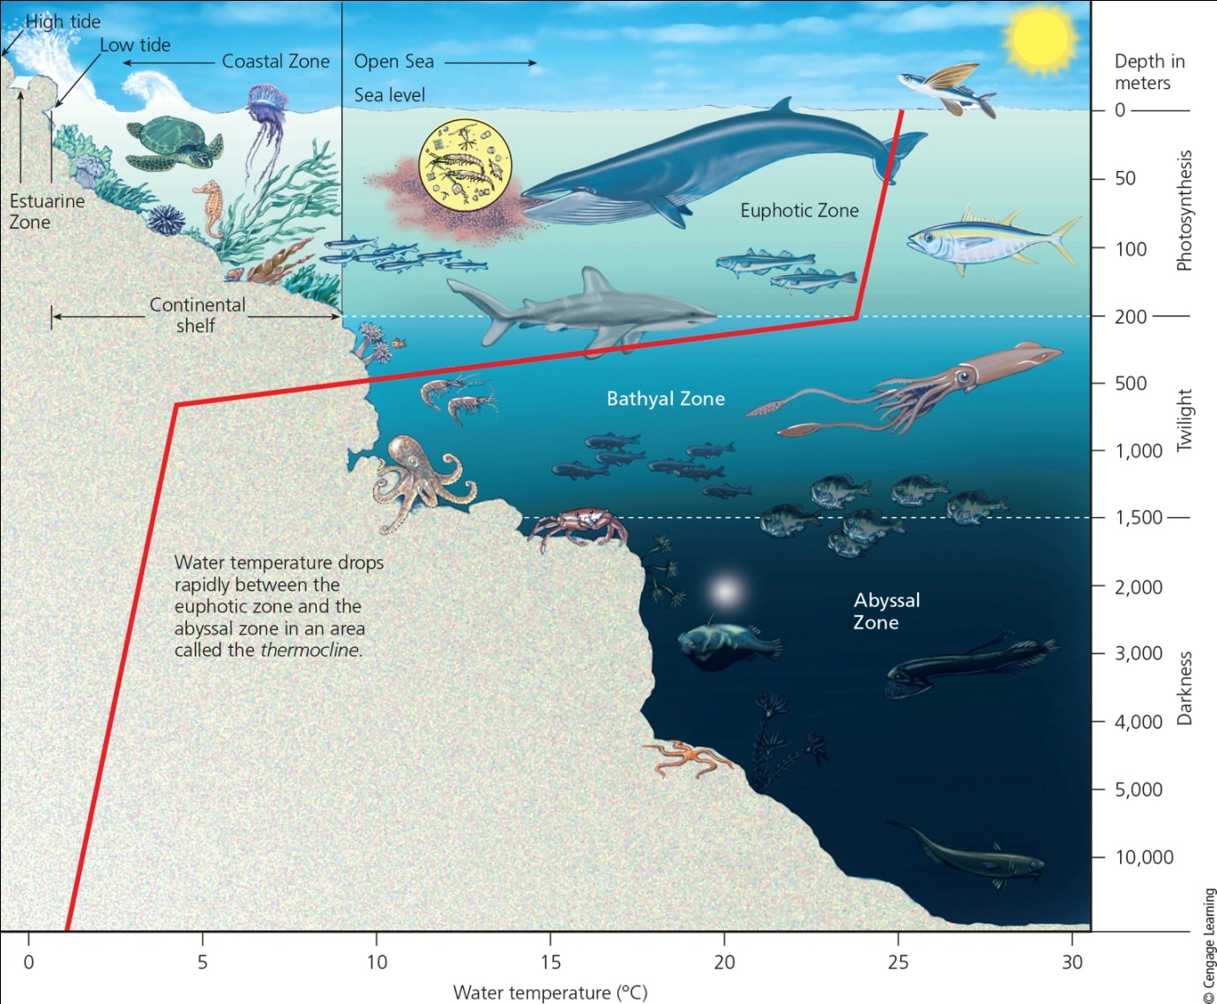
Oceans Provide Vital Ecosystem and Economic Services (4 of 4)
Notes:
Figure 8.5 Major life zones and vertical zones (not drawn to scale) in an ocean. Actual depths of zones may vary. Available light determines the euphotic, bathyal, and abyssal zones. Temperature zones also vary with depth, shown here by the red line. Critical thinking: How is an ocean like a rain forest? (Hint: see Figure 7.20)

Slide 17
Estuaries and Coastal Wetlands Are Highly Productive (1 of 6)
Estuaries
Aquatic zone where river meets the sea
Coastal wetlands
Coastal land covered with water all or part of the year
Include coastal marshes (salt marshes) and mangrove forests
Very productive ecosystems with high nutrient levels

Slide 18
Estuaries and Coastal Wetlands Are Highly Productive (2 of 6)
Seagrass beds
Occur in shallow coastal water
Host up to 60 species of grasses and plants
Support a variety of marine species

Slide 19
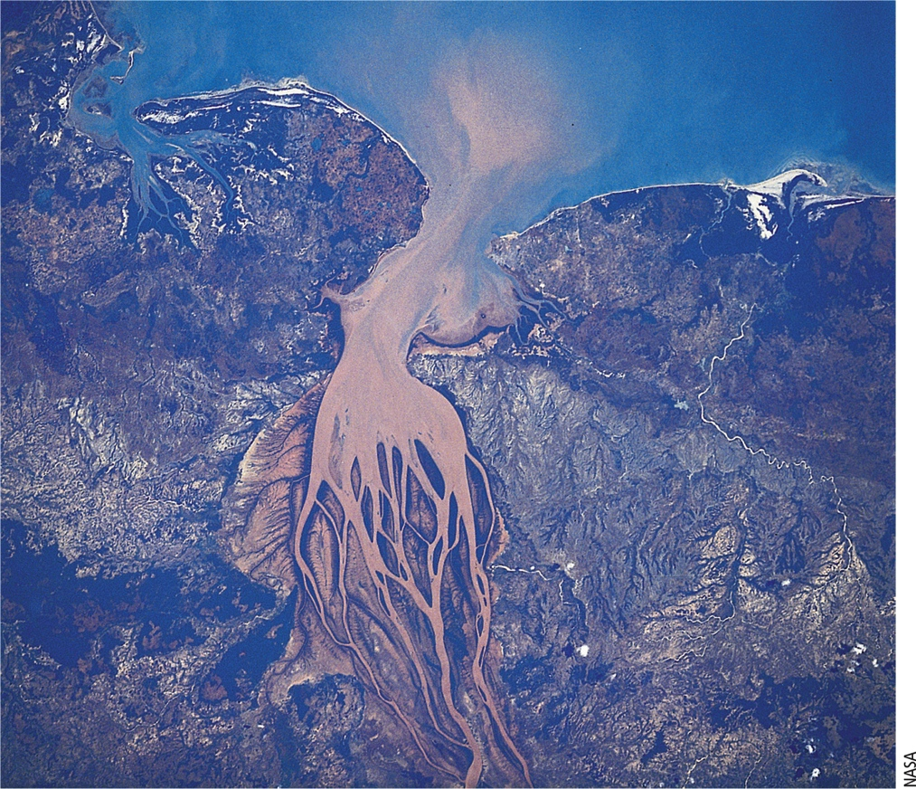
Estuaries and Coastal Wetlands Are Highly Productive (3 of 6)
Notes:
Figure 8.6 Satellite photo of an estuary. A sediment plume (cloudiness caused by runoff) forms at the mouth of Madagascar’s Betsiboka River as it flows through the estuary and into the Mozambique Channel.

Slide 20
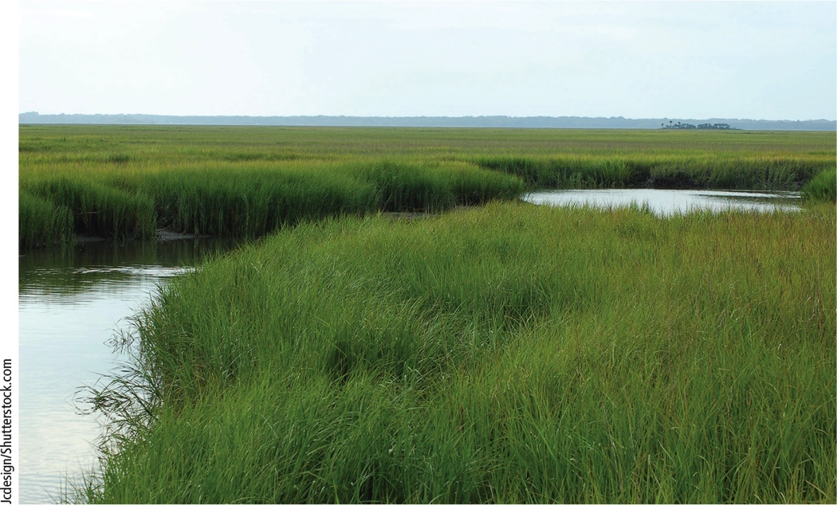
Estuaries and Coastal Wetlands Are Highly Productive (4 of 6)
Notes:
Figure 8.7 Coastal marsh in the U.S. state of South Carolina.

Slide 21
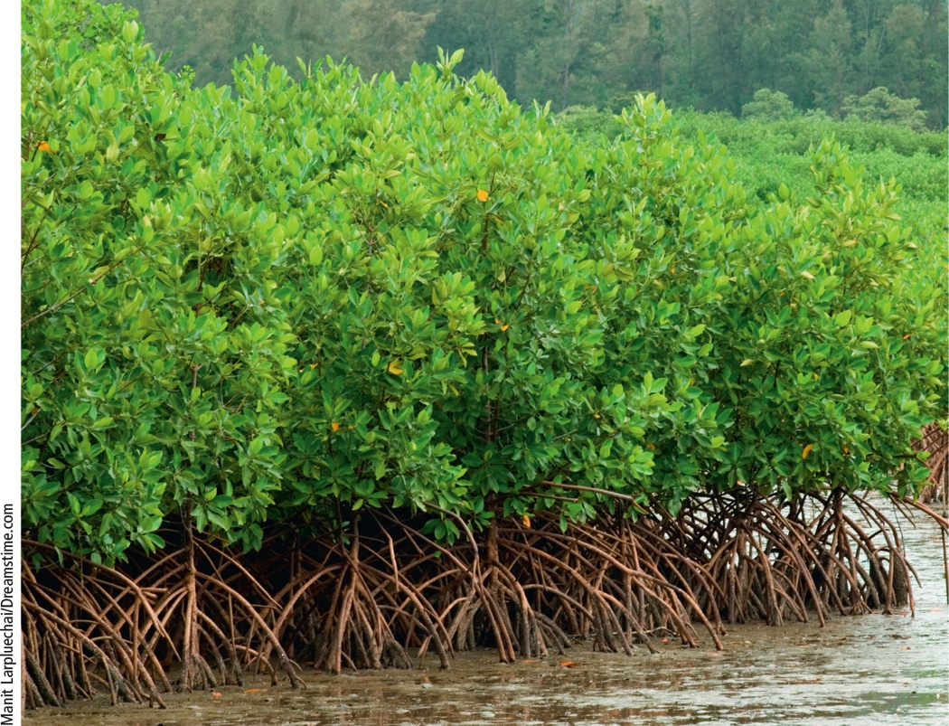
Estuaries and Coastal Wetlands Are Highly Productive (5 of 6)
Notes:
Figure 8.8 Mangrove forest on the coast of Thailand. Mangroves have roots that curve up from the mud and water to obtain oxygen from the air, in the fashion of a snorkel.

Slide 22
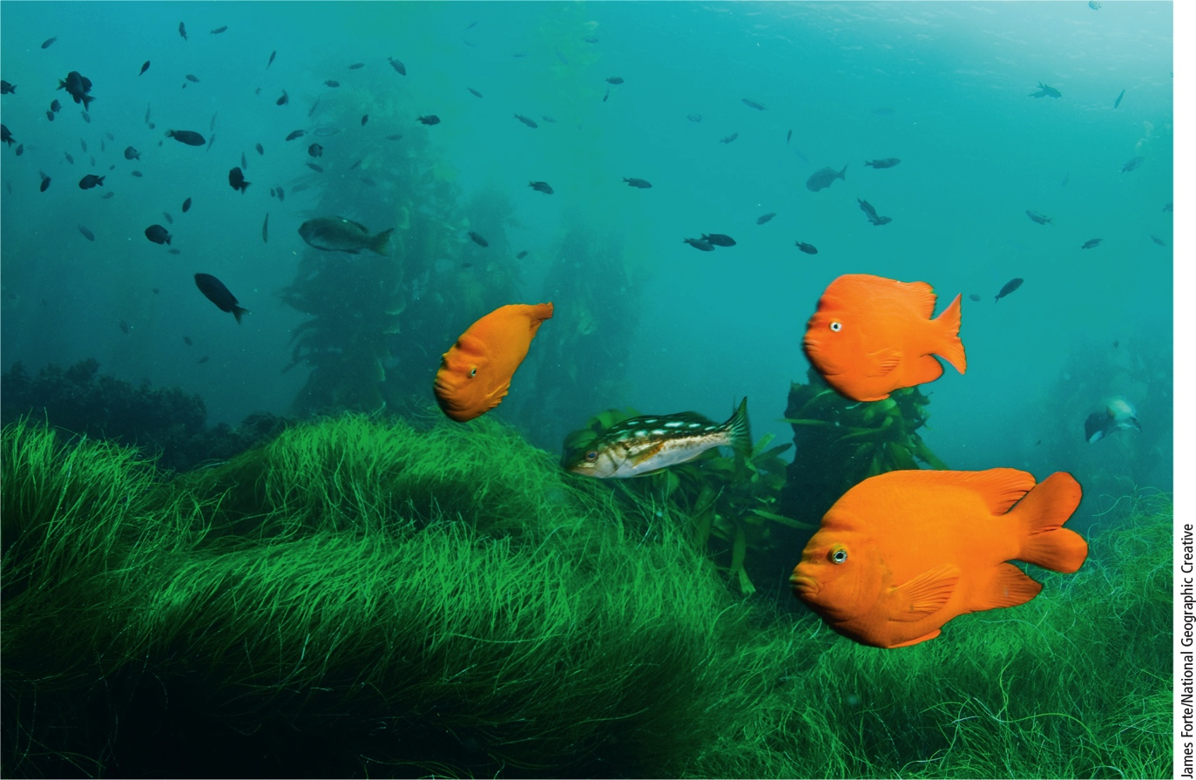
Estuaries and Coastal Wetlands Are Highly Productive (6 of 6)
Notes:
Figure 8.9 Seagrass beds, such as this one near the coast of San Clemente Island, California, support a variety of marine species.

Slide 23
Rocky and Sandy Shores Host Different Types of Organisms (1 of 2)
Intertidal zone
Area of shore between high and low tides
Organisms must survive with daily salinity and moisture changes
Rocky shores
Pounded by waves
Barrier beaches (sandy shores)
Most organisms burrow, dig, or tunnel in sand

Slide 24
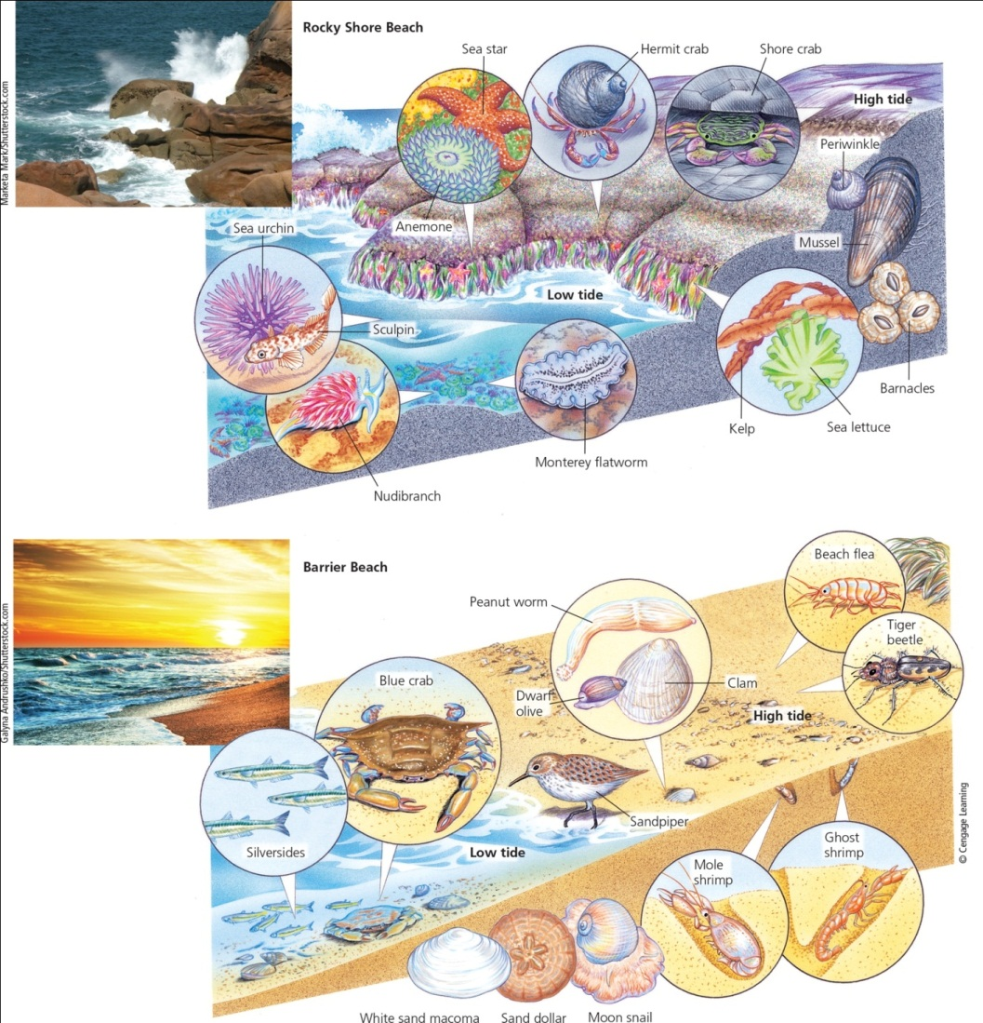
Rocky and Sandy Shores Host Different Types of Organisms (2 of 2)
Notes:
Figure 8.10 Living between the tides: Some organisms with specialized niches are found in various zones on rocky shore beaches (top) and barrier or sandy beaches (bottom). Organisms are not drawn to scale.

Slide 25
Critical Concept: The Importance of Wetlands (1 of 2)
Wetlands are areas that are saturated with water all or part of the year
Have standing shallow water with emergent vegetation
Contain communities of plants and animals that have adapted to continuously wet conditions
Freshwater wetlands include
Swamps
Marshes
Bogs
Fens
Prairie potholes

Slide 26
Critical Concept: The Importance of Wetlands (2 of 2)
Saltwater wetlands include
Estuaries
Mangrove swamps
Coastal marshes
Both provide many ecosystems services

Slide 27
Case Study: Revisiting Coral Reefs -Amazing Centers of Biodiversity
Marine equivalent of tropical rain forests
Reefs are being destroyed and damaged worldwide
Ocean acidification
Oceans absorb CO₂
CO₂ reacts with ocean water to form a weak acid that decreases levels of carbonate ions (CO₃^{2–}) needed to form coral

Slide 28
The Open Sea and the Ocean Floor Host a Variety of Species (1 of 3)
Three vertical zones of the open sea (pelagic zone)
Euphotic zone
Phytoplankton
Nutrient levels low
Dissolved oxygen levels high
Upwelling brings nutrients from below
Bathyal zone
Dimly lit middle zone
Zooplankton and smaller fishes

Slide 29
The Open Sea and the Ocean Floor Host a Variety of Species (2 of 3)
Three vertical zones (cont’d.)
Abyssal zone
Dark and cold
High levels of nutrients
Little dissolved oxygen
Deposit feeders
Filter feeders
NPP low in the open sea
Except in upwelling areas

Slide 30
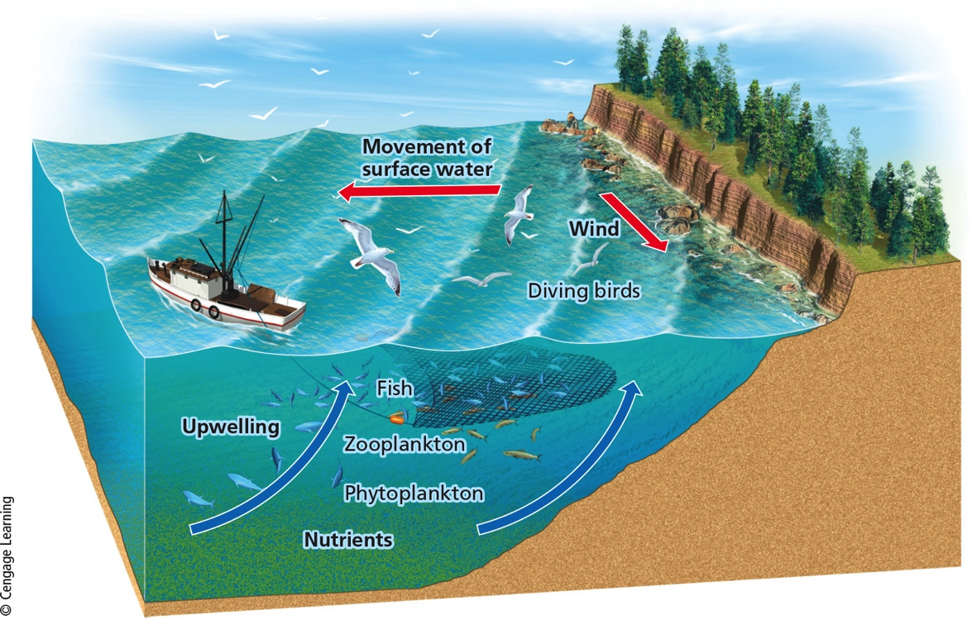
The Open Sea and the Ocean Floor Host a Variety of Species (3 of 3)
Notes:
Figure 8.11 A shore upwelling occurs when deep, cool, nutrient-rich waters are drawn up to replace surface water moved away from a steep coast by wind flowing along the coast toward the equator.

Slide 31
Science Focus 6.1: We Are Still Learning about the Ocean’s Biodiversity
Scientists took census of ocean microbes
Process took 2 years
Sailed around the world, sampling seawater
Counted genetic coding for six million previously undiscovered proteins
Still discovering new genes and proteins at end of voyage
Ocean contains higher diversity of microbial life than previously thought

Slide 32
6.3 How Have Human Activities Affected Marine Ecosystems?
Human activities threaten aquatic biodiversity
Disrupt ecosystem and economic services provided by saltwater systems
Climate change and ocean acidification are largest threats

Slide 33
Human Activities Are Disrupting and Degrading Marine Systems (1 of 2)
Other threats from human activities
Coastal development
Destroys or degrades coastal habitats
Overfishing
Destruction of ocean bottom habitats
Runoff of pollutants
Pollution from ships and tanker spills
Introduction of invasive species

Slide 34
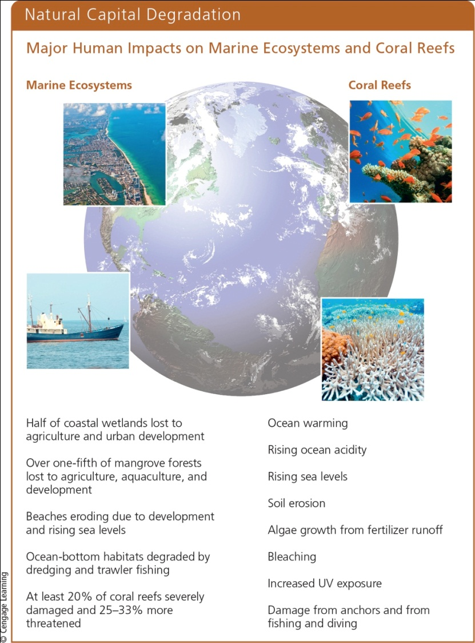
Human Activities Are Disrupting and Degrading Marine Systems (2 of 2)
Notes:
Figure 8.12 Human activities have major harmful impacts on all marine ecosystems (left) and particularly on coral reefs (right) (Concept 8.3). Critical thinking: Which two of the threats to marine ecosystems do you think are the most serious? Why? Which two of the threats to coral reefs do you think are the most serious? Why?

Slide 35
6.4 Why Are Freshwater Ecosystems Important?
Freshwater ecosystems
Provide major ecosystem and economic services
Irreplaceable reservoirs of biodiversity

Slide 36
Water Stands in Some Freshwater Systems and Flows in Others (1 of 5)
Standing (lentic) Surface water
Lakes
Ponds
Inland wetlands
Flowing (lotic) systems of freshwater
Streams
Rivers

Slide 37
Water Stands in Some Freshwater Systems and Flows in Others (2 of 5)
Lakes have four life zones defined by depth and distance from shore
Littoral zone
Shallow water near shore where rooted plants grow; high biodiversity
Turtles, frogs, crayfish, some fish
Limnetic zone
Open, sunlight area away from shore; main photosynthetic zone
Some larger fish

Slide 38
Water Stands in Some Freshwater Systems and Flows in Others (3 of 5)
Lake zones (cont’d.)
Profundal zone
Deep water too dark for photosynthesis
Low oxygen levels
Some fish
Benthic zone
Lake bottom
Decomposers, detritus feeders, and some fish
Nourished primarily by dead matter

Slide 39
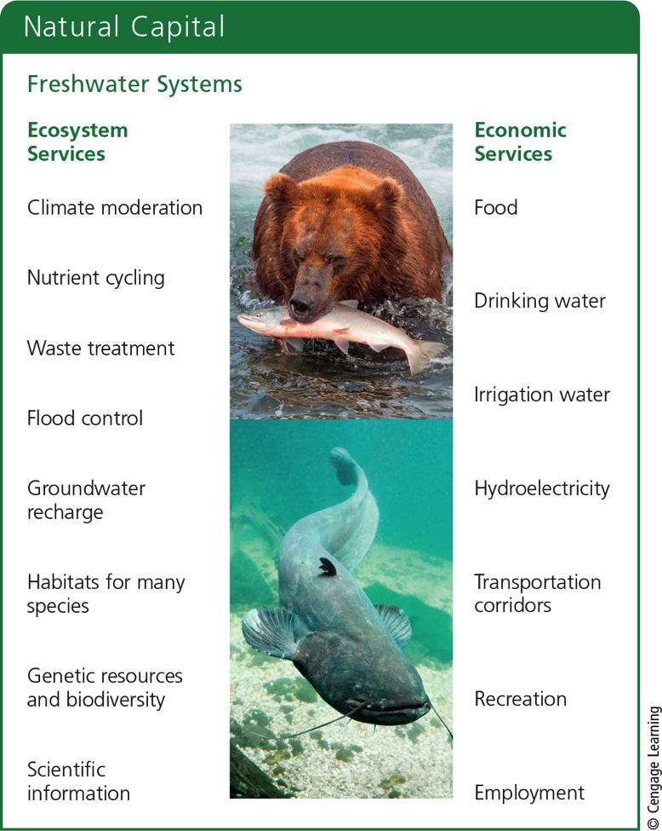
Water Stands in Some Freshwater Systems and Flows in Others (4 of 5)
Notes:
Figure 8.14 Freshwater systems provide many important ecosystem and economic services (Concept 8.4). Critical thinking: Which two ecosystem services and which two economic services do you think are the most important? Why?

Slide 40
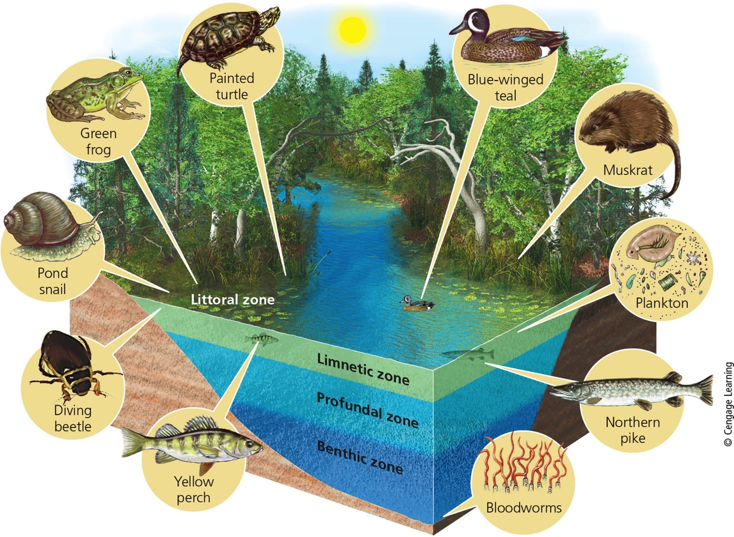
Water Stands in Some Freshwater Systems and Flows in Others (5 of 5)
Notes:
Figure 8.15 A typical deep temperate-zone lake has distinct zones of life. Critical thinking: How are deep lakes similar to tropical rain forests? (Hint: See Figure 7.20)

Slide 41
Some Lakes Have More Nutrients Than Others (1 of 3)
Oligotrophic lakes
Low levels of nutrients and low NPP
Very clear water
Eutrophic lakes
High levels of nutrients and high NPP
Shallow, murky water
Cultural eutrophication of lakes from human input of nutrients

Slide 42
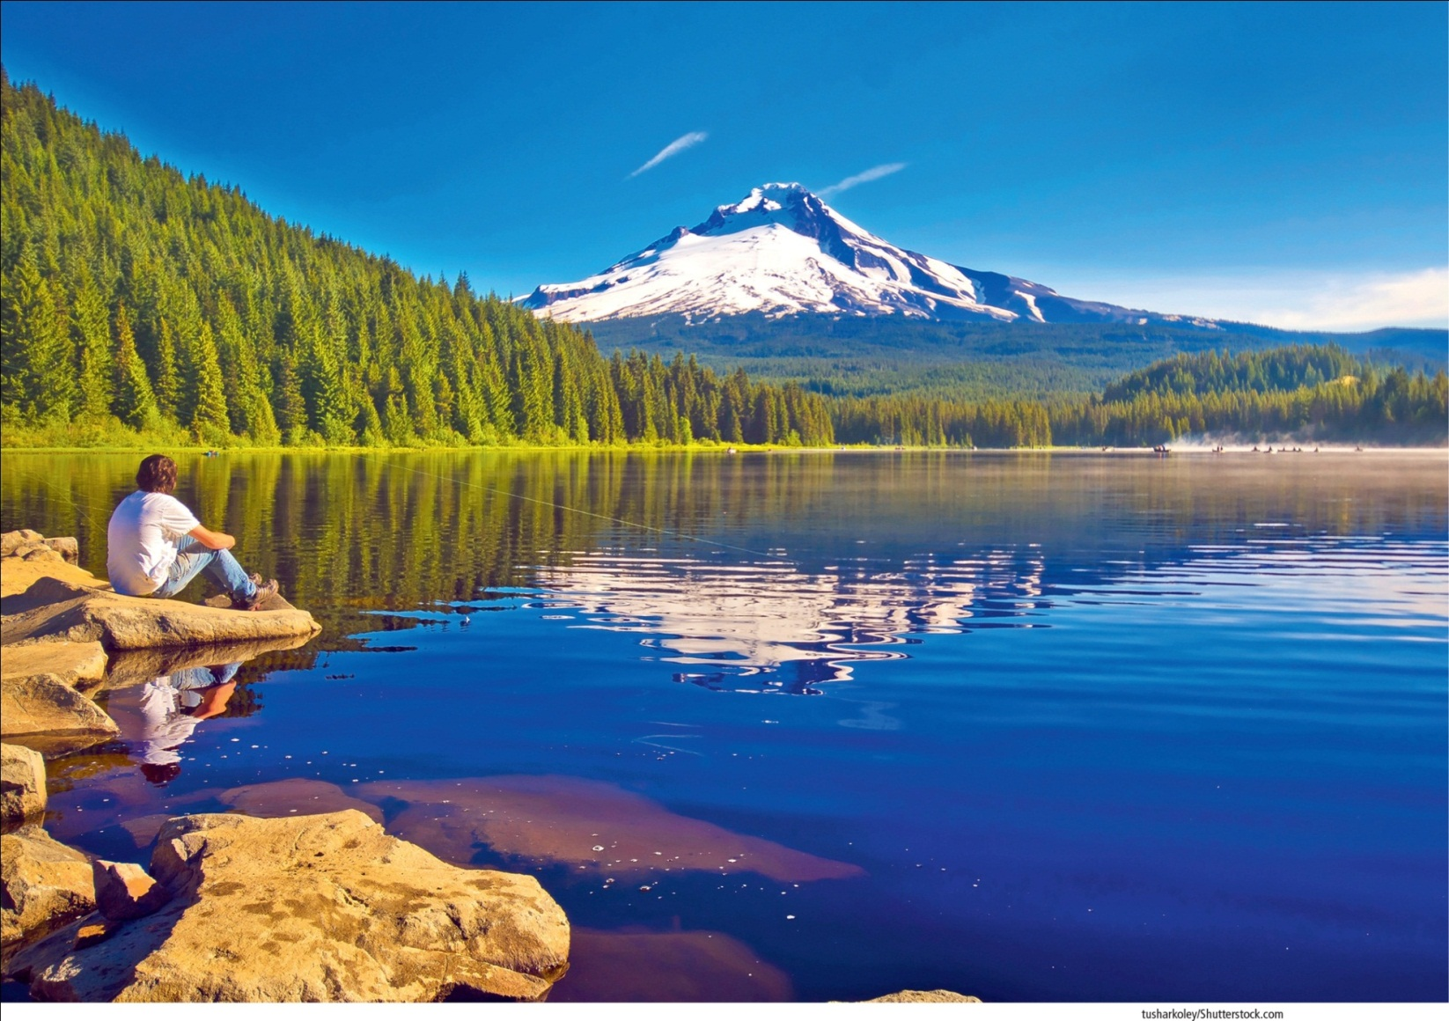
Some Lakes Have More Nutrients Than Others (2 of 3)
Notes:
Figure 8.16 Trillium Lake, in the U.S. state of Oregon, with a view of Mt. Hood.

Slide 43
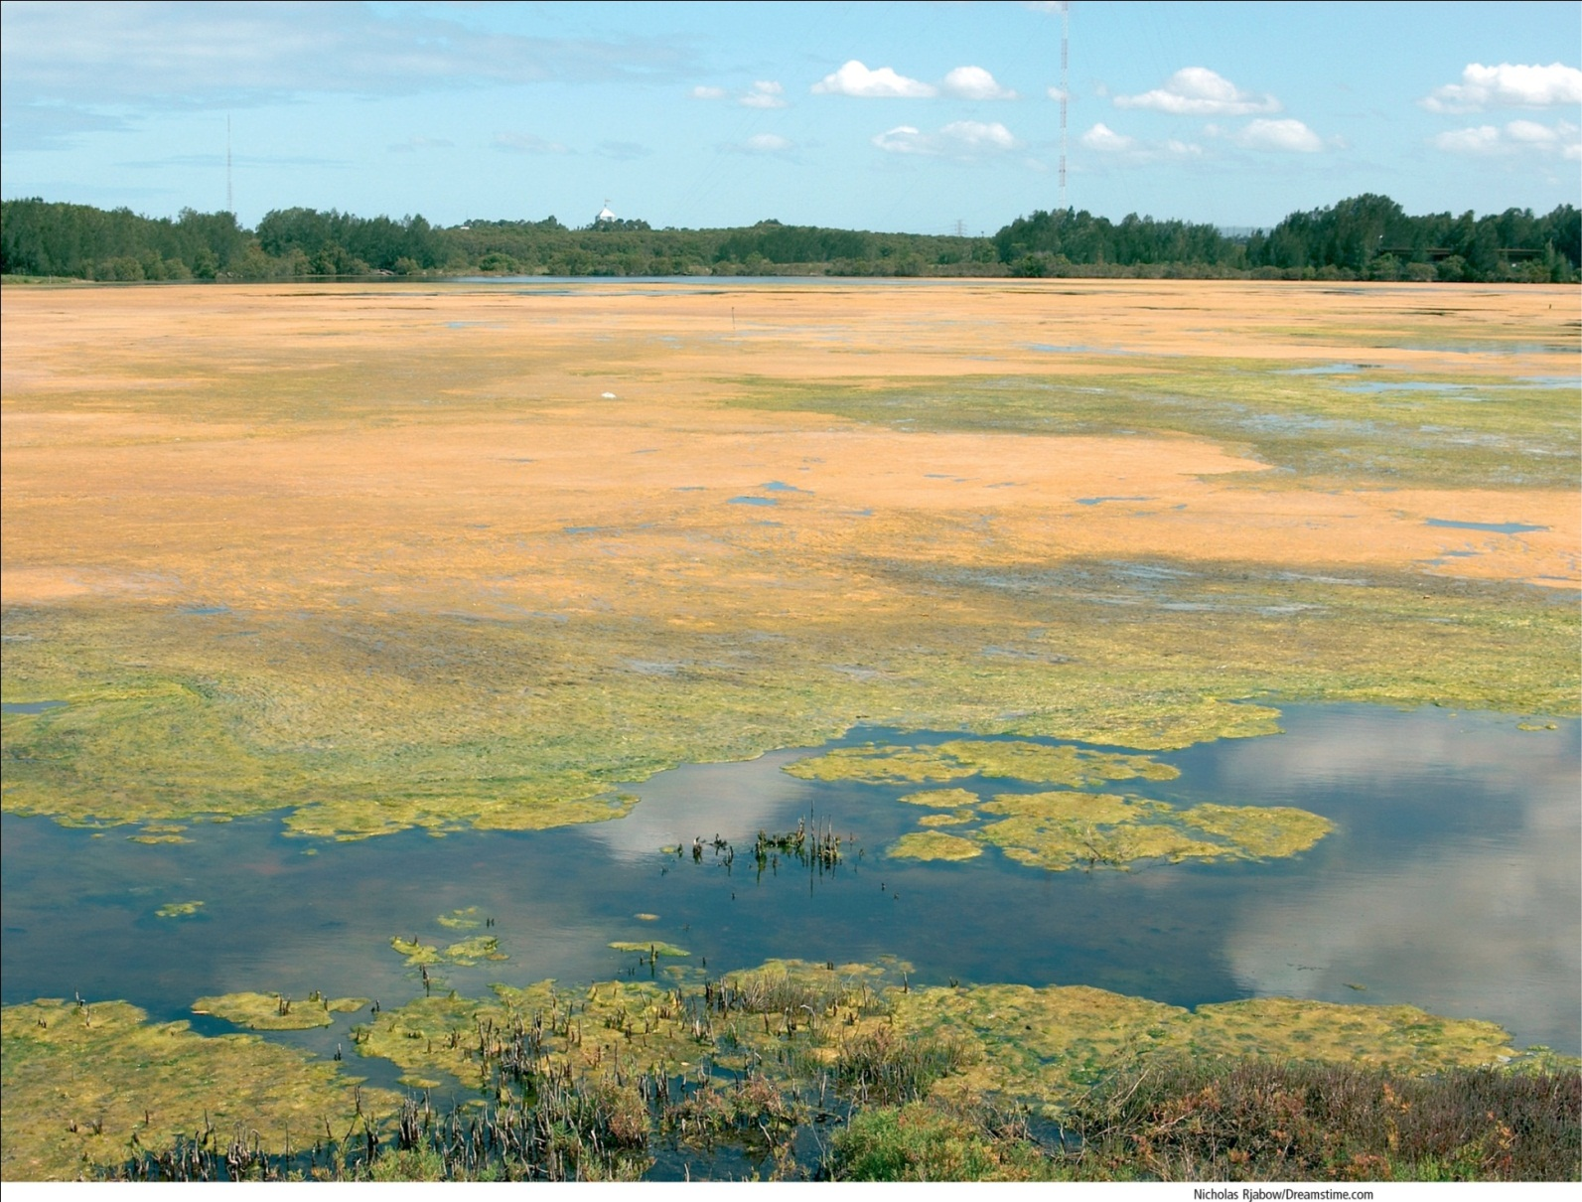
Some Lakes Have More Nutrients Than Others (3 of 3)
Notes:
Figure 8.17 This eutrophic lake has received large flows of plant nutrients. As a result, its surface is covered with mats of algae.

Slide 44
Critical Concept: Cultural Eutrophication (1 of 3)
The physical, chemical, and biological changes that take place when a freshwater system receives an influx of nutrients
Limiting factors for plants (nitrates and phosphates) are taken up quickly and cause an algal bloom

Slide 45
Critical Concept: Cultural Eutrophication (2 of 3)
Sources of nutrients include
Fertilizers from lawns and farms
Phosphates in detergents
Feedlot runoff
Municipal sewage
Runoff from streets
Mining and construction
Nitrogen oxides from air pollution

Slide 46
Critical Concept: Cultural Eutrophication (3 of 3)
Insert figure 6.A. above

Slide 47
Freshwater Streams and Rivers Carry Large Volumes of Water (1 of 3)
Downward flow of surface water and groundwater from mountain highlands
Three aquatic life zones
Source zone
Shallow, cold, clear, swiftly flowing streams
High dissolved oxygen
Nutrients come from organic matter

Slide 48
Freshwater Streams and Rivers Carry Large Volumes of Water (2 of 3)
Aquatic life zones (cont’d.)
Transition zone
Wider, deeper, warmer streams
More turbid, with less dissolved oxygen
Floodplain zone
Wide, deep rivers that flow across broad, flat valleys
Higher temperatures and less dissolved oxygen
Support algae, cyanobacteria, rooted plants

Slide 49
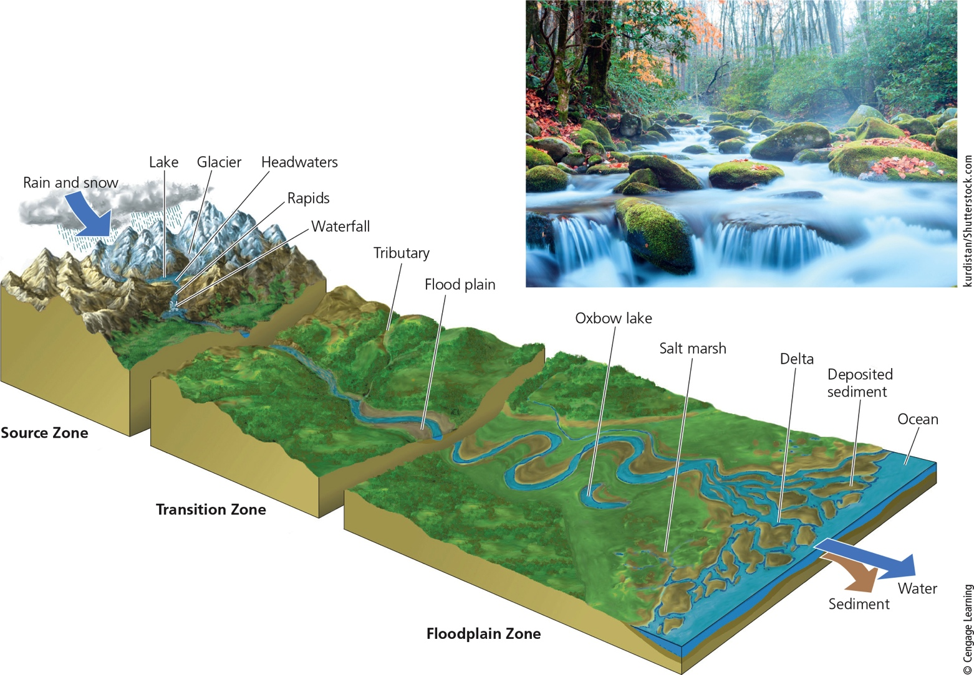
Freshwater Streams and Rivers Carry Large Volumes of Water (3 of 3)
Notes:
Figure 8.18 There are three zones in the downhill flow of water: the source zone, which contains headwater streams found in highlands and mountains (see inset photo); the transition zone, which contains wider, lower-elevation streams; and the floodplain zone, which contains rivers that empty into larger rivers or into the ocean. Critical thinking: How might the building of many dams and reservoirs along a river’s path to the ocean affect its sediment input into the ocean and change the river’s delta?

Slide 50
Freshwater Inland Wetlands Are Vital Sponges (1 of 3)
Inland wetlands
Marshes, swamps, prairie potholes, floodplains, and arctic tundra
Some are seasonal wetlands
Highly productive because of available nutrients
Services provided
Filtering toxic wastes and pollutants
Reducing flooding and erosion

Slide 51
Freshwater Inland Wetlands Are Vital Sponges (2 of 3)
Services provided (cont’d.)
Sustaining stream flows during dry periods
Recharging groundwater aquifers
Providing habitats for a variety of species
Supplying valuable products
Fishes, shellfish, blueberries, cranberries, and rice
Providing recreation

Slide 52
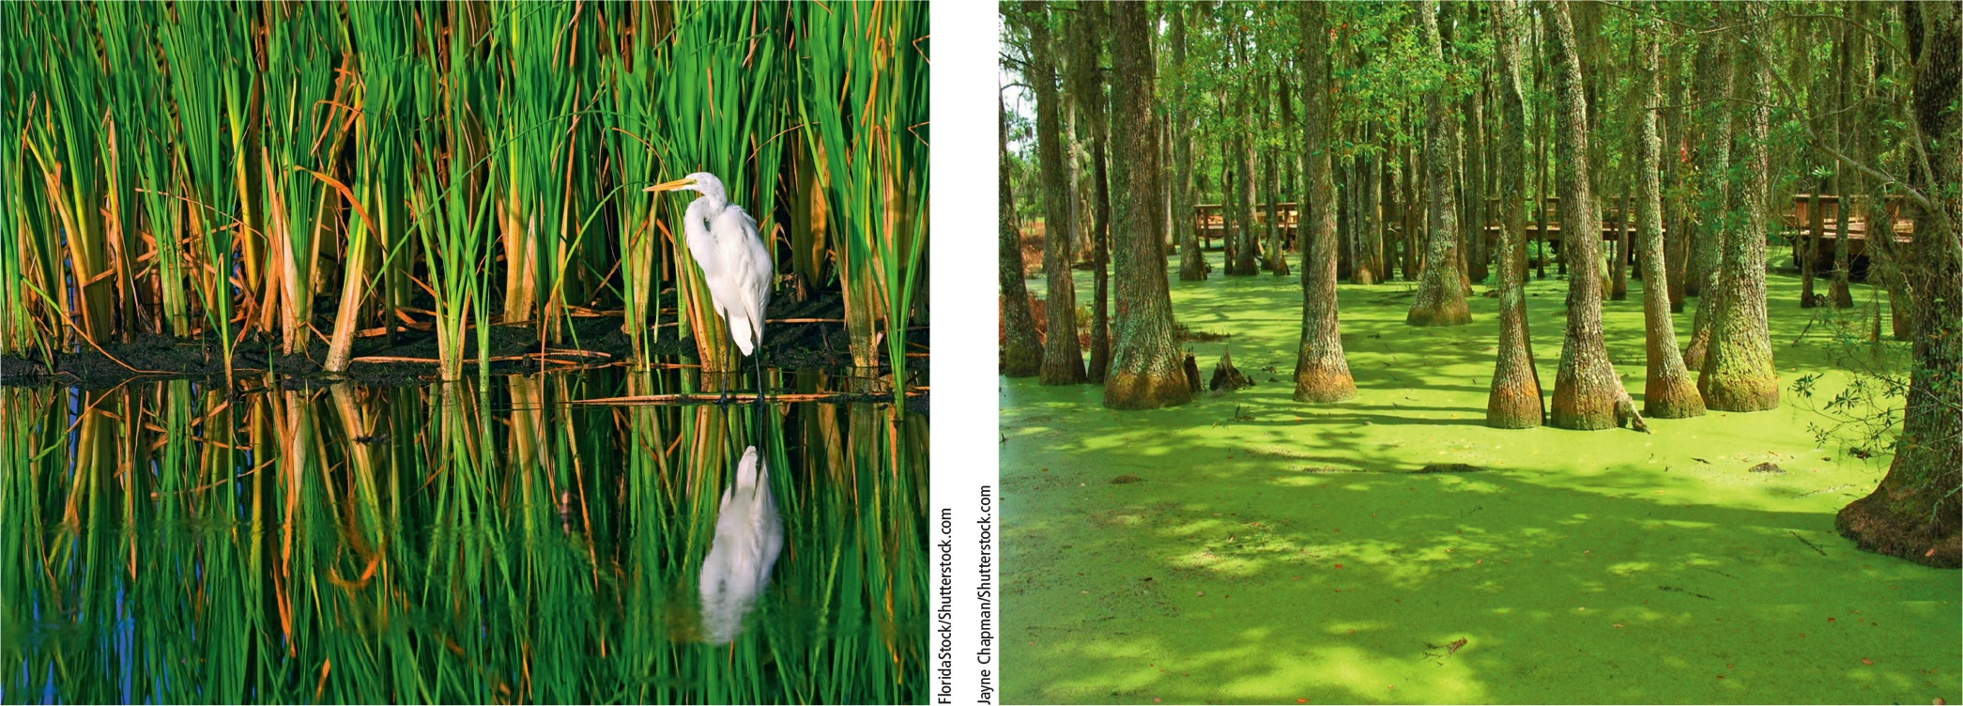
Freshwater Inland Wetlands Are Vital Sponges (3 of 3)
Notes:
Figure 8.19 This great white egret lives in an inland marsh in the Florida Everglades (left). This cypress swamp (right) is located in South Carolina.

Slide 53
6.5 How Have Human Activities Affected Freshwater Ecosystems?
Human activities threaten biodiversity and disrupt ecosystem and economic services provided by freshwater lakes, rivers, and wetlands

Slide 54
Human Activities Are Disrupting and Degrading Freshwater Systems
Dams and canals restrict the flows of rivers
40% of the world’s largest rivers
Flood-control destroys aquatic habitats and alters wetlands
Cities and farms pollute water
Many wetlands have been drained for human purposes

Slide 55
River Deltas and Coastal Wetlands–Vital Components of Natural Capital Now In Jeopardy
River deltas, coastal wetlands, and mangrove forests
Provide natural protection against flood and wave damage during storms
Degraded ecosystems allow intensified damage
Building dams reduces river sediment deposited downstream
Result: river deltas subside (sink) into the sea

Slide 56
Key Ideas (1 of 2)
Saltwater and freshwater aquatic life zones cover almost three-fourths of the earth’s surface
Oceans dominate the planet
The earth’s aquatic systems provide important ecosystem and economic services

Slide 57
Key Ideas (2 of 2)
Certain human activities threaten biodiversity and disrupt ecosystem and economic services provided by aquatic systems

