Slide 1
Exploring Environmental Science for AP®
1st Edition
Chapter 5
Climate and Terrestrial Biodiversity
Copyright © 2018 Cengage Learning. All Rights Reserved. May not be copied, scanned, or duplicated, in whole or in part, except for use as permitted in a license distributed with a certain product or service or otherwise on a password-protected website for classroom use.

Slide 2
7.1 What Factors Influence Weather?
Weather
Set of physical conditions of the lower atmosphere in an area over a period of hours to days
Atmospheric temperature and precipitation
Weather affected by:
Moving masses of warm or cold air
Atmospheric pressure changes
Occasional shifts in major winds

Slide 3
Weather is Affected by Moving Masses of Warm or Cold Air (1 of 2)
Front
Boundary between two air masses with different temperatures and densities
Warm front
Advancing warm air mass rises up over cooler air
Moisture begins to condense
Forms layers of clouds at different altitudes

Slide 4
Weather is Affected by Moving Masses of Warm or Cold Air (2 of 2)
Cold front
Advancing cold air mass stays close to the ground, wedging below warmer air
Produces rapidly moving, towering clouds called thunderheads
Can cause high surface winds and thunderstorms as it passes through

Slide 5
Weather is Affected by Atmospheric Pressure and Wind Patterns (1 of 5)
Atmospheric pressure
Greater near the earth’s surface
High pressure air mass contains cool, dense air
Low pressure air mass contains low-density, warm air
Air rises, expands, and cools
Condenses when temperature drops below dew point

Slide 6
Weather is Affected by Atmospheric Pressure and Wind Patterns (2 of 5)
Weather fronts: A warm front (left) occurs when a moving mass of warm air meets and rises up over a mass of denser cool air. A cold front (right) forms when a moving mass of cold air wedges beneath a mass of less dense warm air.
Notes:
Figure 7.2 Weather fronts: A warm front (left) occurs when a moving mass of warm air meets and rises up over a mass of denser cool air. A cold front (right) forms when a moving mass of cold air wedges beneath a mass of less dense warm air.

Slide 7
Weather is Affected by Atmospheric Pressure and Wind Patterns (3 of 5)
Jet streams
Powerful winds that circle the globe
El Niño-Southern Oscillation (ENSO)
Periodic change in wind patterns in the Pacific Ocean
Results in drier weather in some areas and wetter in others
Can alter conditions over two-thirds of the world

Slide 8
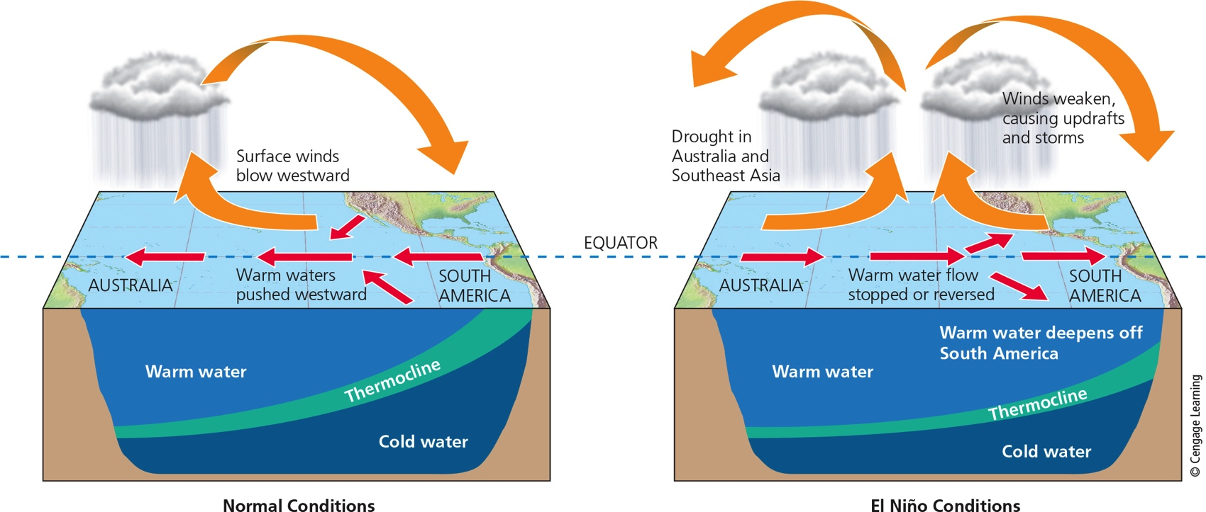
Weather is Affected by Atmospheric Pressure and Wind Patterns (4 of 5)
Notes:
Figure 7.3 El Niño: Normal trade winds blowing east to west cause shore upwellings of cold, nutrient-rich bottom water in the tropical Pacific Ocean near the coast of Peru (left). A zone of gradual temperature change called the thermocline separates the warm and cold water. Every few years, a shift in trade winds known as the El Niño–Southern Oscillation (ENSO) disrupts this pattern (right) for 1 to 2 years.

Slide 9
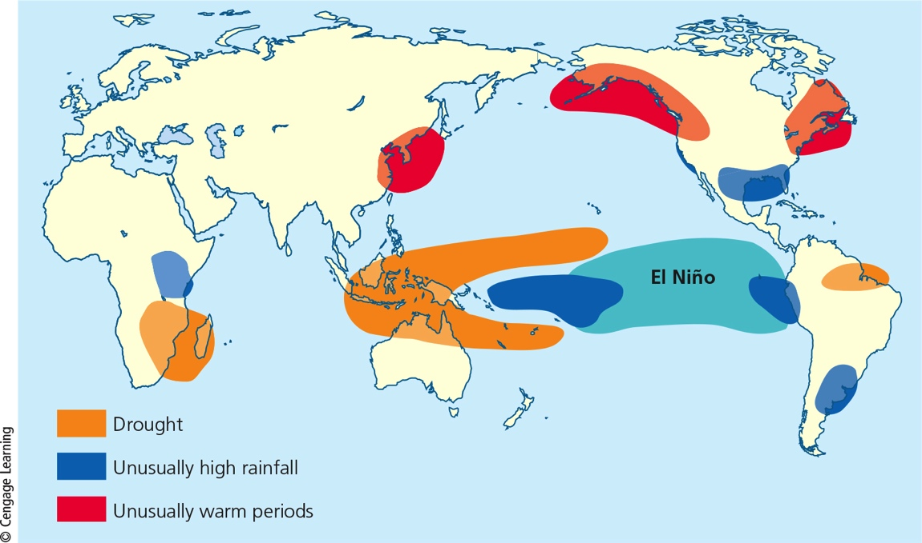
Weather is Affected by Atmospheric Pressure and Wind Patterns (5 of 5)
Notes:
Figure 7.4 Typical global weather effects of an El Niño–Southern Oscillation. Critical thinking: How might an ENSO affect the weather where you live or go to school?

Slide 10
Tornados and Tropical Cyclones Are Violent Weather Extremes (1 of 3)
Tornadoes
Violent weather event that forms over land
Vertical convection currents suck air upward
Most occur in American Midwest in spring
Tropical cyclones
Form over warm ocean waters
Take a long time to form and gain strength
Intensities rated based on wind speeds

Slide 11
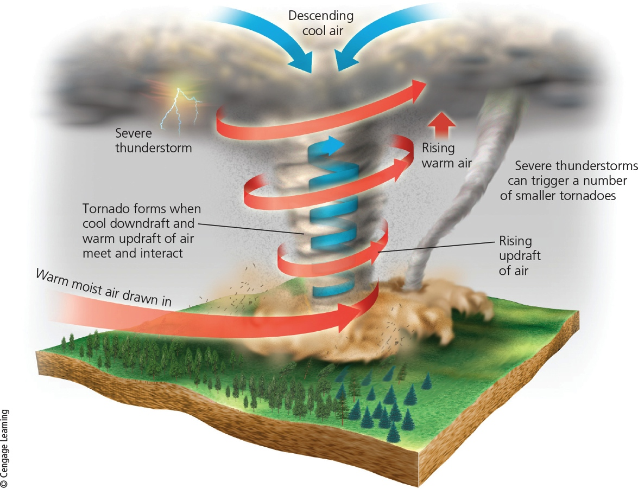
Tornados and Tropical Cyclones Are Violent Weather Extremes (2 of 3)
Notes:
Figure 7.5 Formation of a tornado, or twister. The most active tornado season in the United States is usually March through August.

Slide 12
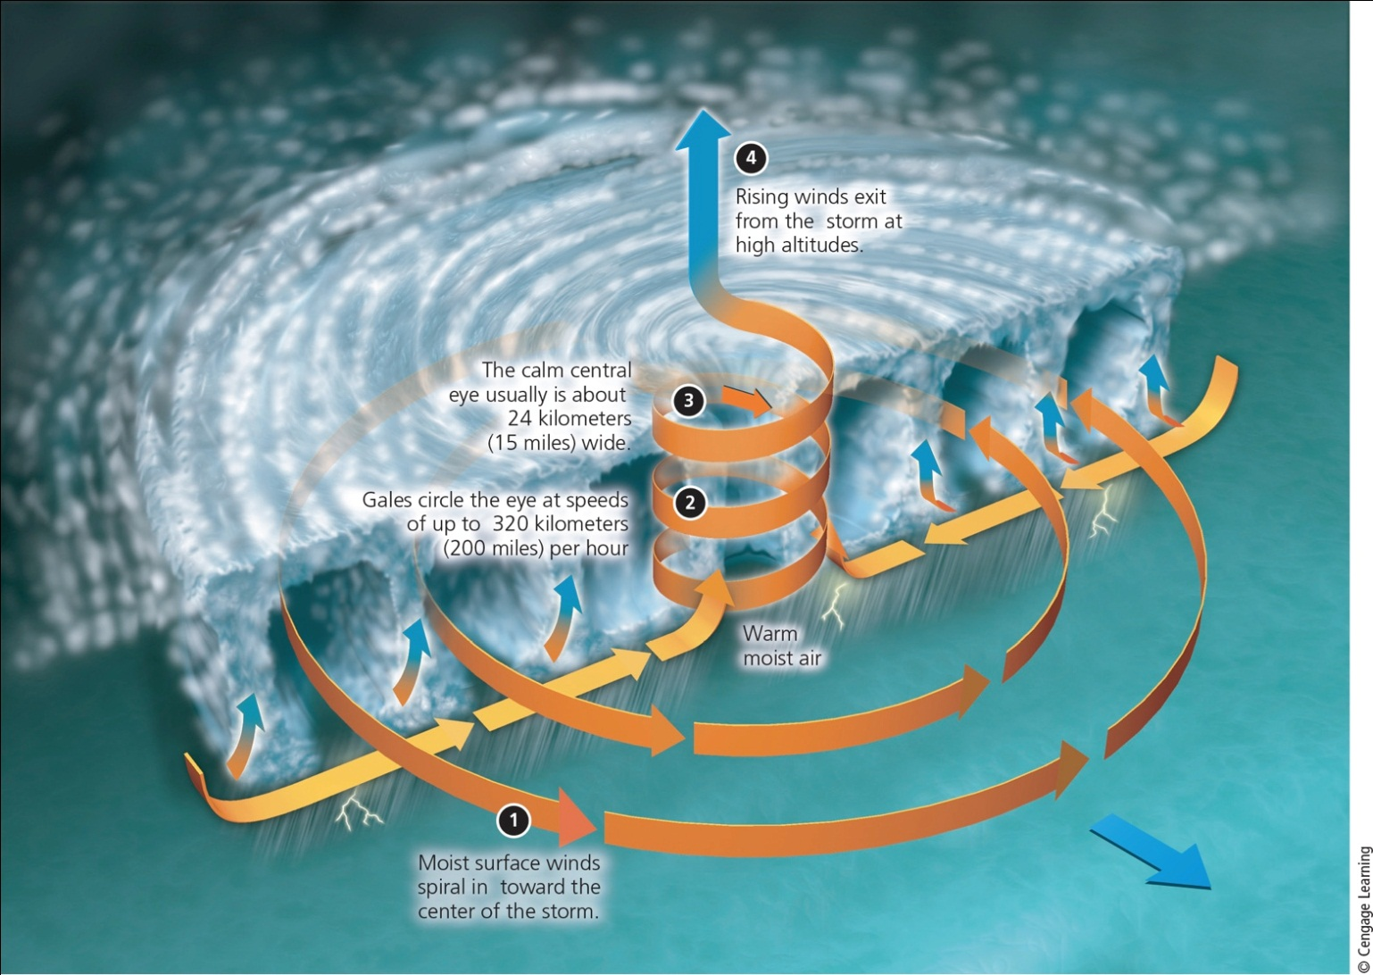
Tornados and Tropical Cyclones Are Violent Weather Extremes (3 of 3)
Notes:
Figure 7.6 Formation of a tropical cyclone. Those forming in the Atlantic Ocean are called hurricanes. Those forming in the Pacific Ocean are called typhoons.

Slide 13
Several Factors Affect Regional Climates (1 of 7)
Weather
Temperature, precipitation, wind speed, and cloud cover
Hours to days
Climate
Area’s general pattern of atmospheric conditions over three decades and longer
Varies among the earth’s different regions

Slide 14
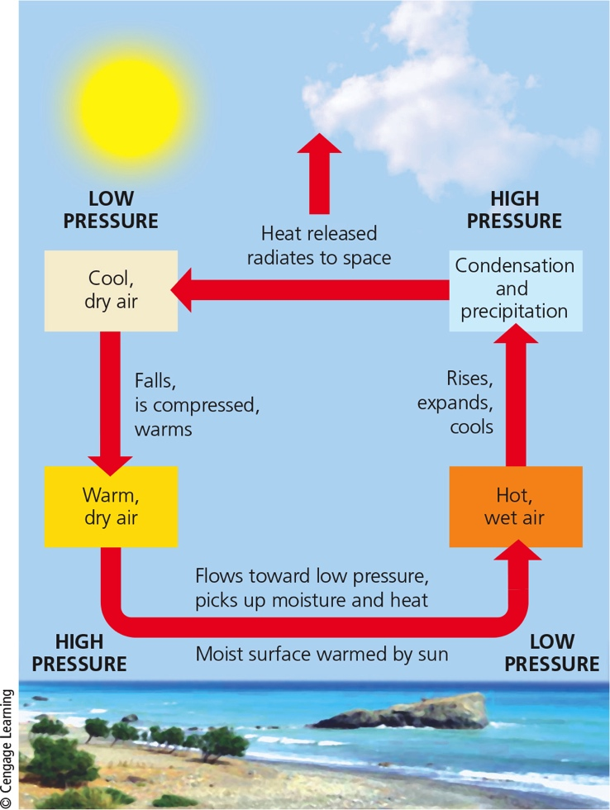
Several Factors Affect Regional Climates (4 of 7)
Convection cells play a key role in transferring energy (heat) and moisture through the atmosphere from place to place on the planet.
Notes:
Figure 7.8 Convection cells play a key role in transferring energy (heat) and moisture through the atmosphere from place to place on the planet.

Slide 15
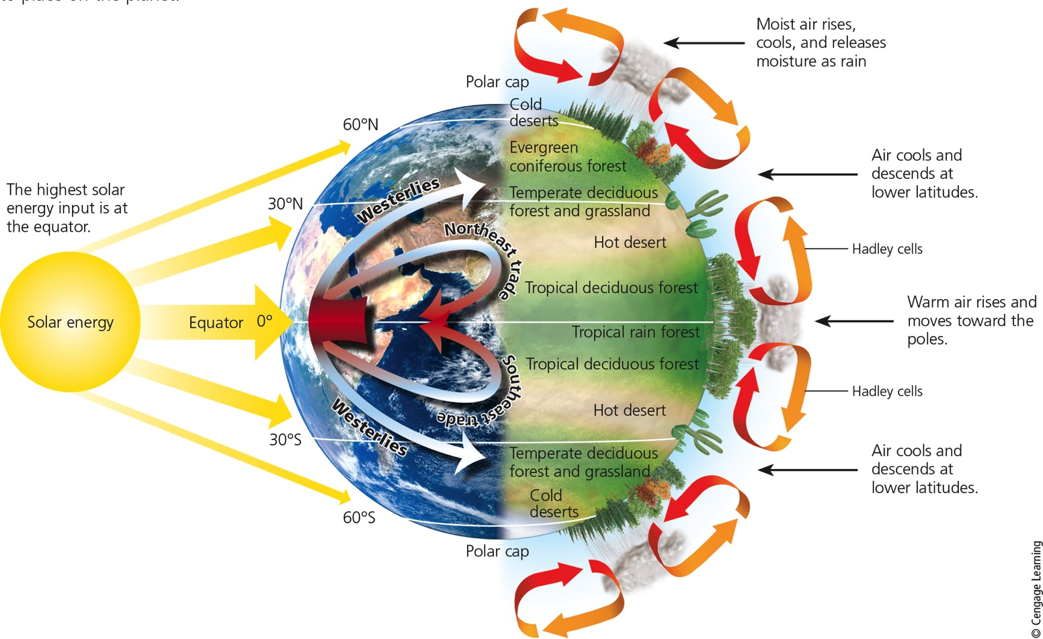
Several Factors Affect Regional Climates (5 of 7)
Notes:
Figure 7.9 Global air circulation: Air rises and falls in giant convection cells (right). Air flowing away from the equator is deflected to the east and air flowing toward the equator is deflected west, due to the Coriolis effect. This creates global patterns of prevailing winds (left) that help to distribute heat and moisture in the atmosphere, which leads to the earth’s variety of forests, grasslands, and deserts (right).

Slide 16
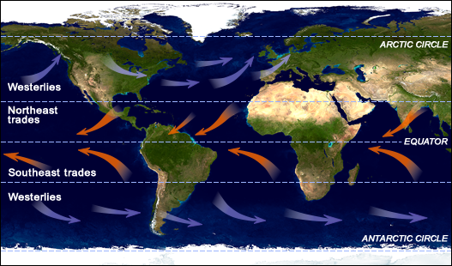

Slide 17
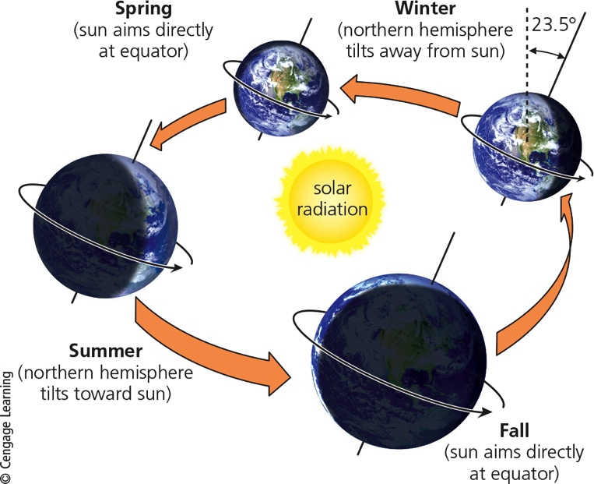
Several Factors Affect Regional Climates (6 of 7)
The earth’s axis is tilted about 23.5°with respect to the plane of the earth’s path around the sun. The resulting variations in solar energy reaching the northern and southern hemispheres throughout a year result in seasons.
Notes:
Figure 7.10 The earth’s axis is tilted about 23.5° with respect to the plane of the earth’s path around the sun. The resulting variations in solar energy reaching the northern and southern hemispheres throughout a year result in seasons. Critical thinking: How might your life be different if the earth’s axis was not tilted?

Slide 18
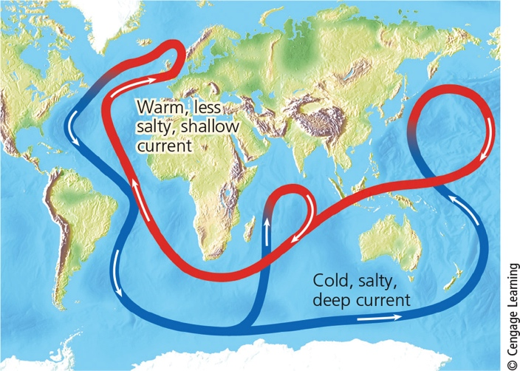
Several Factors Affect Regional Climates (7 of 7)
Notes:
Figure 7.11 A connected loop of deep and shallow ocean currents transports warm and cool water to various parts of the earth.

Slide 19
Greenhouse Gases Warm the Lower Atmosphere
Greenhouse gases
H₂O
CO₂
CH₄
N₂O
Natural greenhouse effect
Gases keep the earth habitable
Human-enhanced global warming

Slide 20
The Earth’s Surface Features Affect Local Climates (1 of 2)
Mountains interrupt flow of prevailing winds
Rain shadow effect
Most precipitation falls on the windward side of mountain ranges
Deserts leeward
Cities create microclimates
Heat islands

Slide 21
The Earth’s Surface Features Affect Local Climates (2 of 2)
The rain shadow effect is a reduction of rainfall and loss of moisture from the landscape on the leeward side of a mountain. Warm, moist air in onshore winds loses most of its moisture as rain and snow that fall on the windward slopes of a mountain range. This leads to semiarid and arid conditions on the leeward side of the mountain range and on the land beyond.
Notes:
Figure 7.12 The rain shadow effect is a reduction of rainfall and loss of moisture from the landscape on the leeward side of a mountain. Warm, moist air in onshore winds loses most of its moisture as rain and snow that fall on the windward slopes of a mountain range. This leads to semiarid and arid conditions on the leeward side of the mountain range and on the land beyond.

Slide 22
Critical Concepts: Valuation of Natural Capital (2 of 3)
Important ecosystem services include
Pollination
Clean water
Seed dispersal
Soil fertility
Decomposition of organic waste
Pest control
Flood control
Climate regulation
Cycling of nutrients
benefits arising from the ecological functions of ecosystems.

Slide 23
Humans Have Disturbed Much of the Earth’s Land (1 of 2)
About 60% of world’s major terrestrial ecosystems being degraded or used unsustainably
The human ecological footprint is spreading across the globe

Slide 24
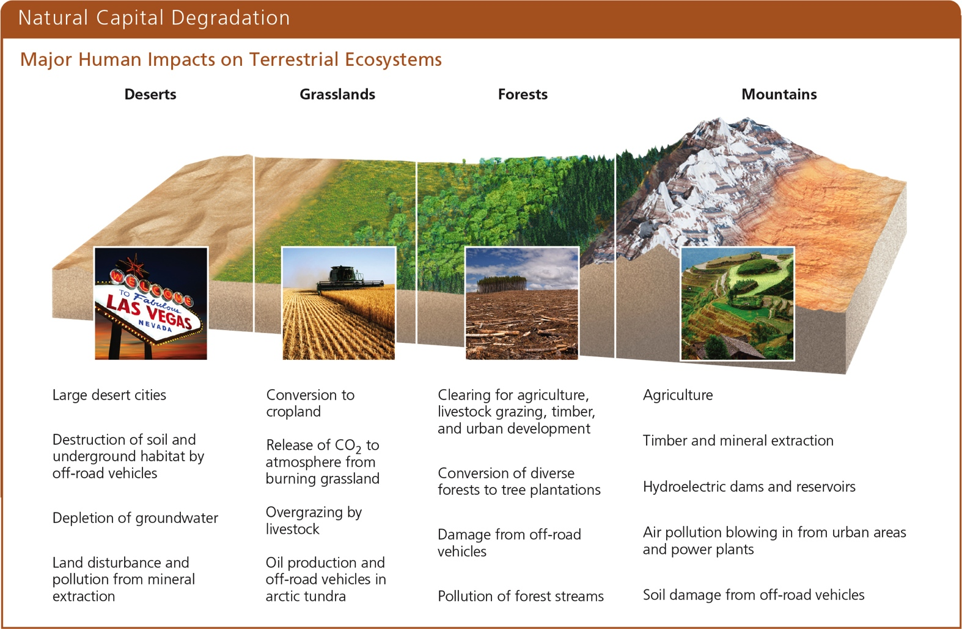
Humans Have Disturbed Much of the Earth’s Land (2 of 2)
Notes:
Figure 7.24 Human activities have had major impacts on the world’s deserts, grasslands, forests, and mountains, as summarized here. Critical thinking: For each of these biomes, which two of the impacts listed do you think are the most harmful? Explain.

