Slide 1
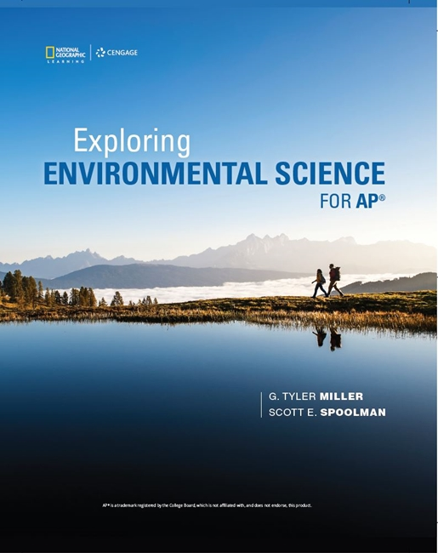
Exploring Environmental Science for AP®
1st Edition
Chapter 3
Ecosystems: What Are They and How Do They Work?
Copyright © 2018 Cengage Learning. All Rights Reserved. May not be copied, scanned, or duplicated, in whole or in part, except for use as permitted in a license distributed with a certain product or service or otherwise on a password-protected website for classroom use.

Slide 2
Core Case Study: Tropical Rain Forests Are Disappearing
Tropical rain forests near the earth’s equator
Cover only about 2% of the earth’s land
Contain up to one-half of the world’s known terrestrial plant and animal species
Major harmful effects of disruption
Reduces biodiversity
Accelerates climate change
Changes regional weather patterns

Slide 3
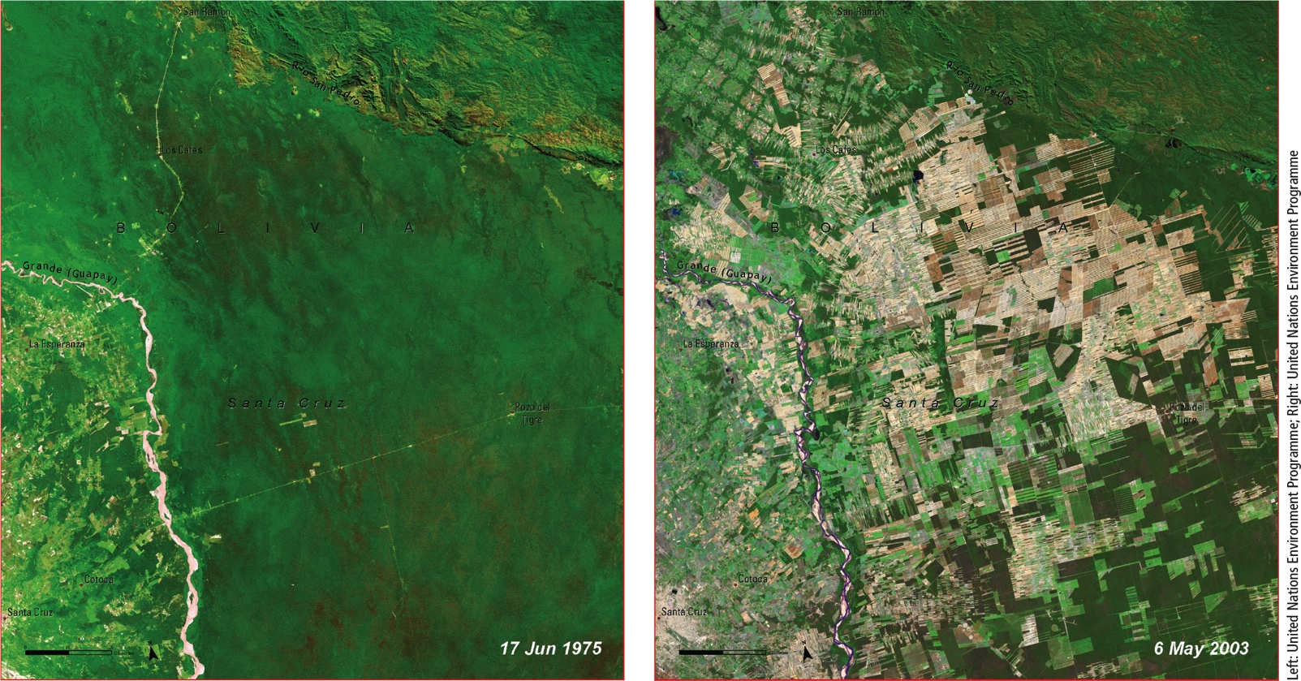
Natural Capital Degradation
Notes:
Figure 3.1 Natural capital degradation. Satellite image of the loss of tropical rain forest, cleared for farming, cattle grazing, and settlements, near the Bolivian city of Santa Cruz between June 1975 (left) and May 2003 (right). This is the latest available view of the area, but forest degradation has continued since 2003.

Slide 4
3.1 How Does the Earth’s Life-Support System Work?
Major components of the earth’s life-support system
Atmosphere (air)
Hydrosphere (water)
Geosphere (rocks, minerals, and soil)
Biosphere (living things)

Slide 5
Earth’s Life-Support System Has Four Major Components (1 of 3)
Atmosphere
Innermost layer is the troposphere
Contains the air we breathe
Stratosphere: contains ozone layer
Filters sun’s harmful UV radiation
Hydrosphere
All water vapor, liquid water, and ice
Oceans contain 97% of the planet’s water

Slide 6
Earth’s Life-Support System Has Four Major Components (2 of 3)
Geosphere
Upper portion of crust contains nutrients organisms need to live, grow, and reproduce
Contains nonrenewable fossil fuels
Biosphere
Parts of atmosphere, hydrosphere, and geosphere where life is found

Slide 7
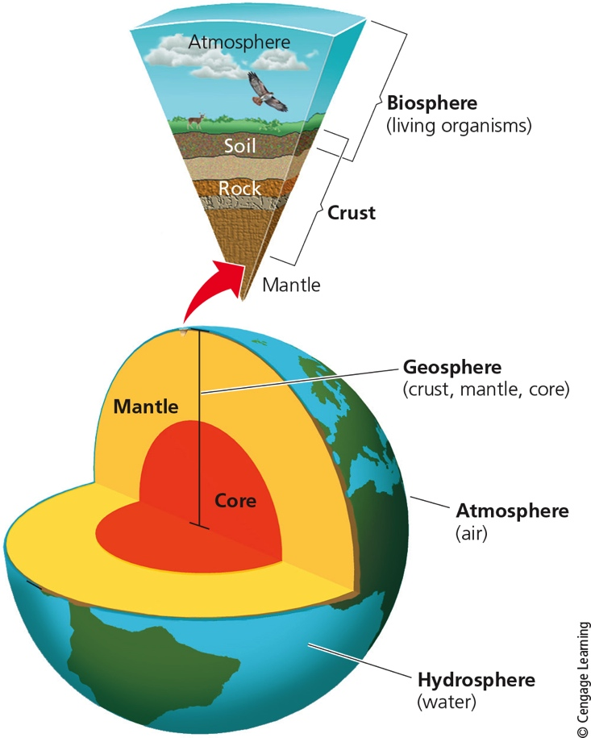
Earth’s Life-Support System Has Four Major Components (3 of 3)
Notes:
Figure 3.2 Natural capital: The earth consists of a land sphere (geosphere), an air sphere (atmosphere), a water sphere (hydrosphere), and a life sphere (biosphere).

Slide 8
Three Factors Sustain the Earth’s Life (1 of 2)
One-way flow of high-quality energy from the sun
Supports plant growth and warms troposphere
Cycling of nutrients through parts of the biosphere
Gravity holds the earth’s atmosphere
Enables movement and cycling of chemicals through air, water, soil, and organisms

Slide 9
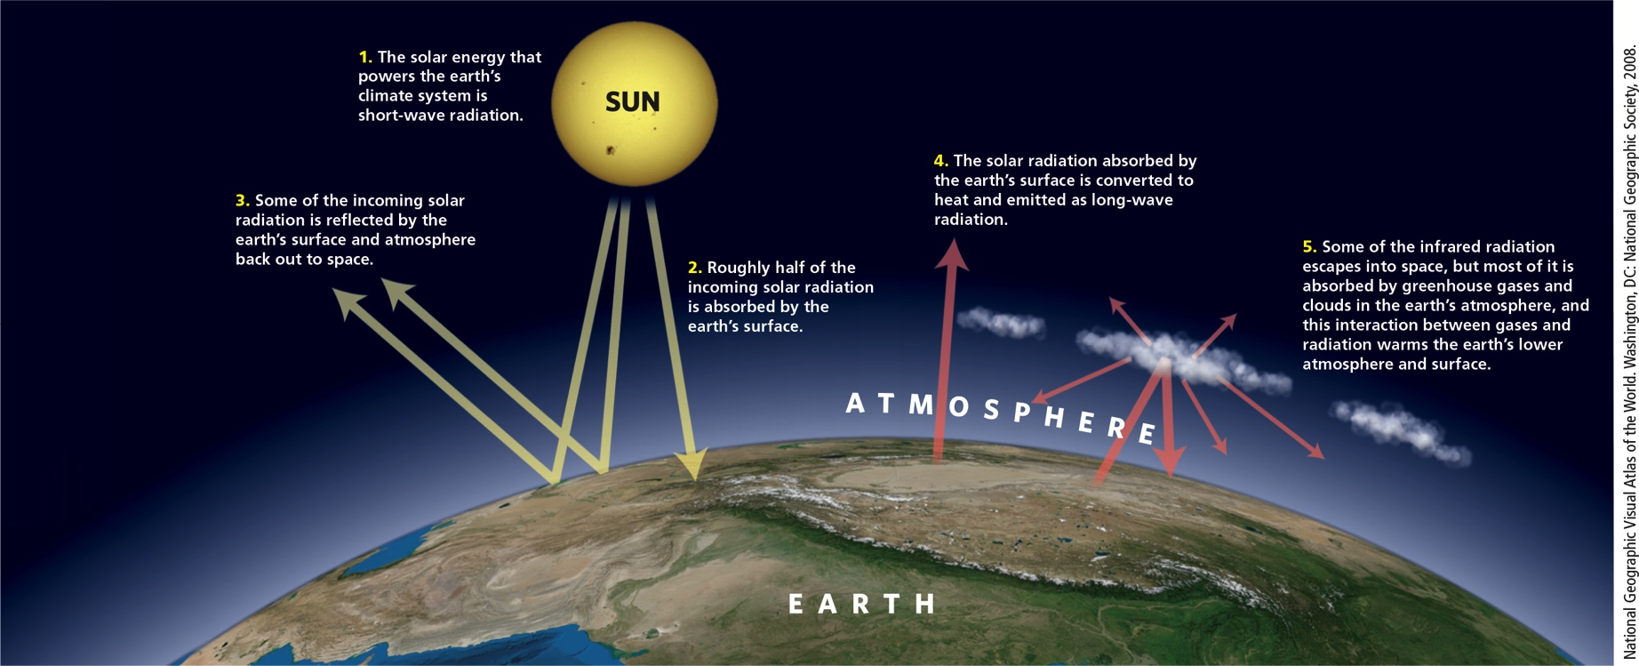
Three Factors Sustain the Earth’s Life (2 of 2)
Notes:
Figure 3.3 Greenhouse Earth. High-quality solar energy flows from the sun to the earth. It is degraded to lower-quality energy (mostly heat) as it interacts with the earth’s air, water, soil, and life-forms, and eventually returns to space. Certain gases in the earth’s atmosphere retain enough of the sun’s incoming energy as heat to warm the planet in what is known as the greenhouse effect.

Slide 10
3.2 What Are the Major Components of an Ecosystem? (1 of 3)
Ecologists study five levels of matter
Biosphere, ecosystems, communities, populations, and organisms
Feeding level (trophic level)
Organisms classified as producers or consumers based on source of nutrients
Producers (autotrophs) make needed nutrients from their environment

Slide 11
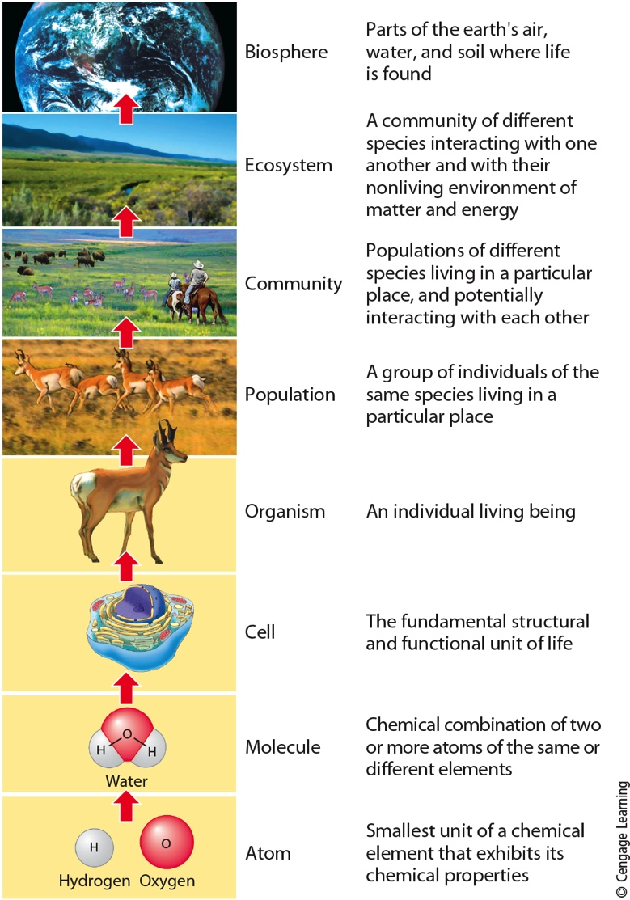
3.2 What Are the Major Components of an Ecosystem? (2 of 3)
Notes:
Figure 3.4 Ecology focuses on the top five of these levels of the organization of matter in nature.

Slide 12
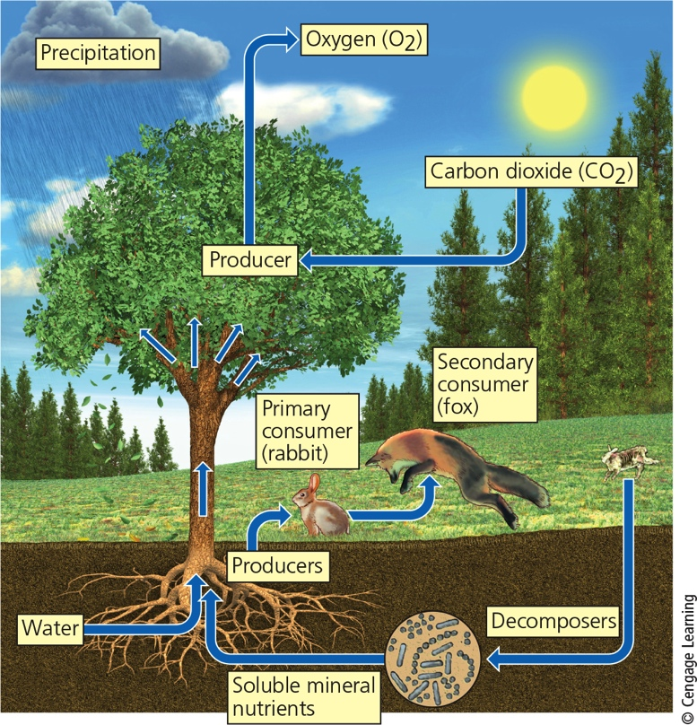
3.2 What Are the Major Components of an Ecosystem? (3 of 3)
Notes:
Figure 3.5 Key living (biotic) and nonliving (abiotic) components of an ecosystem in a field.

Slide 13
Ecosystems Have Several Important Components (1 of 7)
During photosynthesis, plants generate energy and emit oxygen
CO₂ + H₂O + sunlight → glucose + oxygen
Consumers (heterotrophs) cannot produce the nutrients they need
Primary consumers (herbivores) eat plants
Carnivores feed on flesh of other animals
Secondary and tertiary (or higher) consumers
Omnivores eat both plants and animals

Slide 14
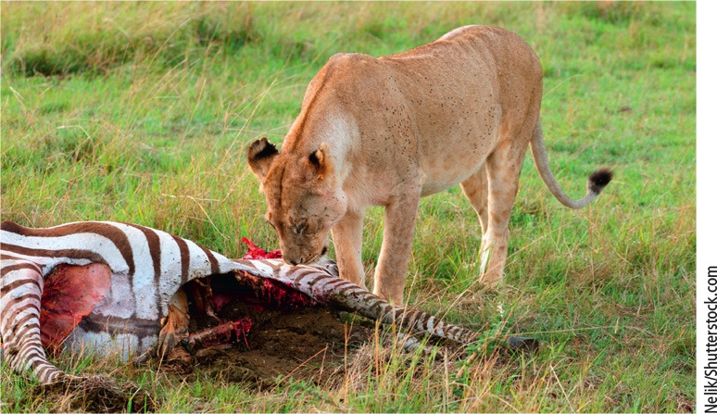
Ecosystems Have Several Important Components (2 of 7)
Notes:
Figure 3.6 This lioness (a carnivore) is feeding on a freshly killed zebra (an herbivore) in Kenya, Africa.

Slide 15
Ecosystems Have Several Important Components (3 of 7)
Decomposers
Consumers that release nutrients from wastes or remains of plants or animals
Nutrients return to soil, water, and air for reuse
Bacteria, fungi
Detritivores

Slide 16
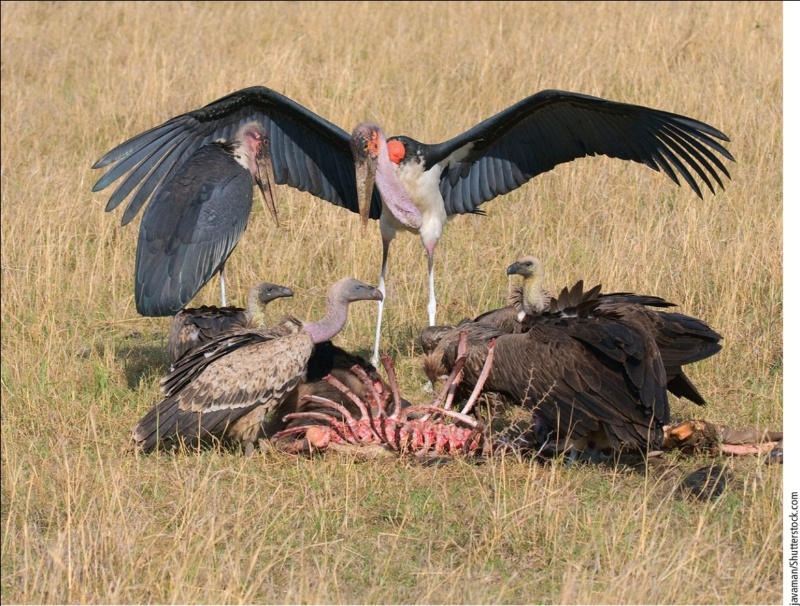
Ecosystems Have Several Important Components (4 of 7)
Notes:
Figure 3.7 The vultures and Marabou storks, eating the carcass of an animal that was killed by another animal, are detritivores.

Slide 17
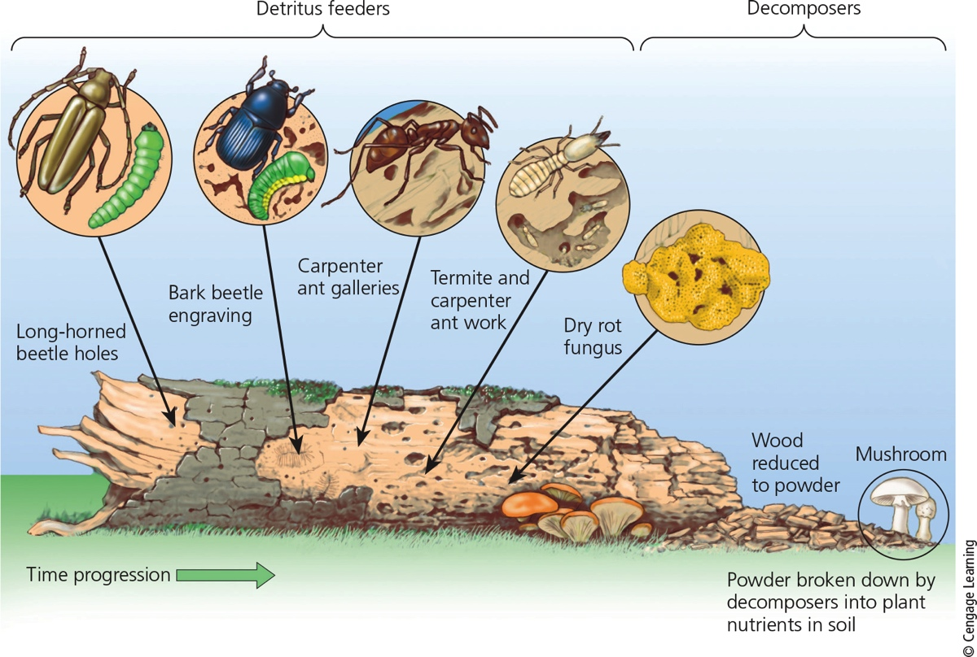
Ecosystems Have Several Important Components (5 of 7)
Notes:
Figure 3.8 Various detritivores and decomposers (mostly fungi and bacteria) can “feed on” or digest parts of a log and eventually convert its complex organic chemicals into simpler inorganic nutrients that can be taken up by producers.

Slide 18
Ecosystems Have Several Important Components (6 of 7)
Producers, consumers, and decomposers use chemical energy stored in glucose
In most cells, energy is released by aerobic respiration
Using oxygen to turn glucose back to carbon dioxide and water

Slide 19
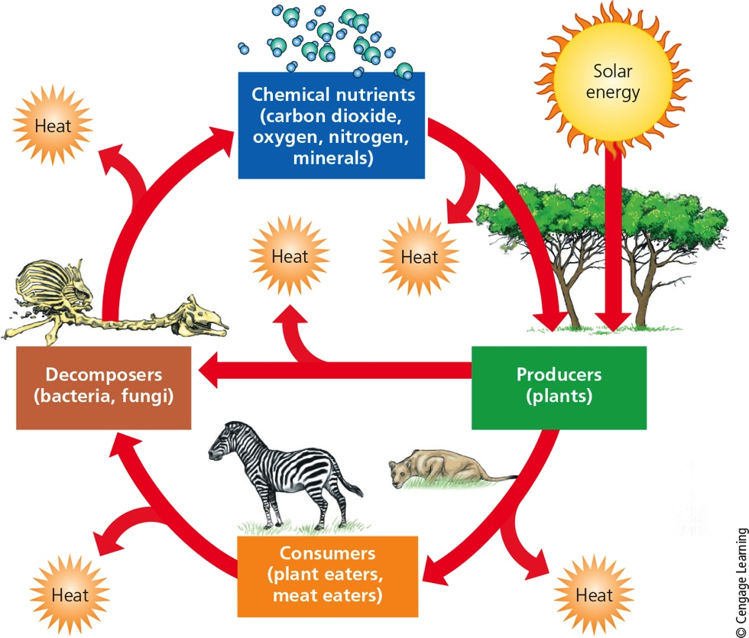
Ecosystems Have Several Important Components (7 of 7)
Notes:
Figure 3.9 Natural capital: The main components of an ecosystem are energy, chemicals, and organisms. Nutrient cycling and the flow of energy—first from the sun, then through organisms, and finally into the environment as low-quality heat—link these components.

Slide 20
Soil Is the Foundation of Life on Land
Soil
Complex mixture of rock, particles, mineral nutrients, organic matter, water, air, and living organisms
Soil is a renewable resource, but renewed very slowly

Slide 21
3.3 What Happens to Energy in an Ecosystem? (1 of 6)
Energy flows through ecosystems in food chains and webs
Food chain
Movement of energy and nutrients from one trophic level to the next
Food web
Network of interconnected food chains

Slide 22
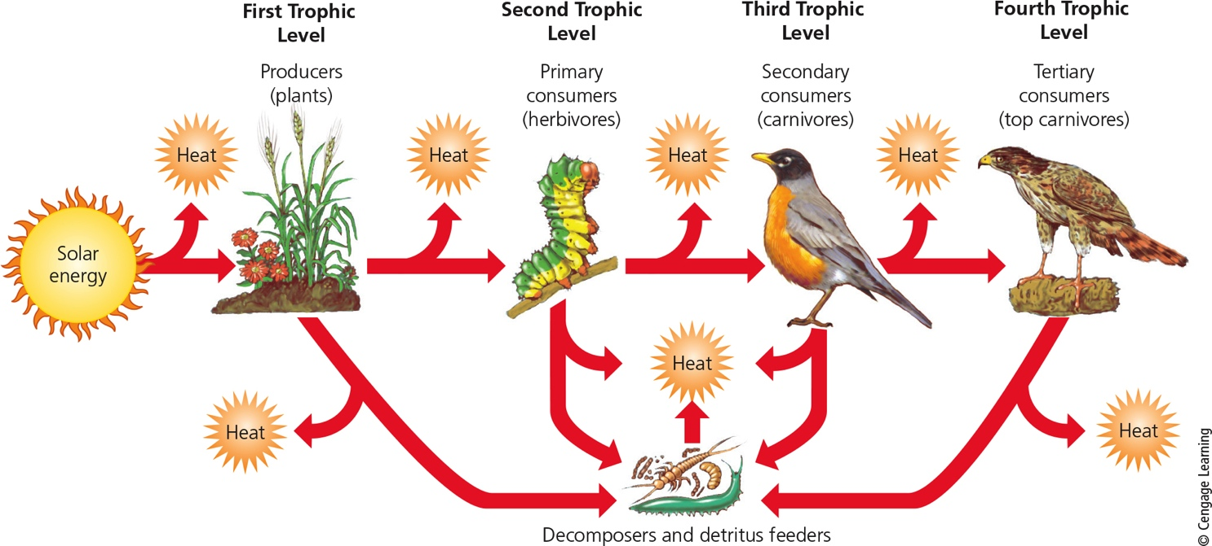
What Happens to Energy in an Ecosystem? (2 of 6)
Notes:
Figure 3.14 In a food chain, chemical energy in nutrients flows through various trophic levels. Question: Think about what you ate for breakfast. At what level or levels on a food chain were you eating?

Slide 23
What Happens to Energy in an Ecosystem? (3 of 6)
Every use and transfer of energy involves energy loss as heat
Pyramid of energy flow
90% of usable energy lost with each transfer
Less chemical energy for higher trophic levels
Biomass
Total mass of organisms in a given trophic level

Slide 24
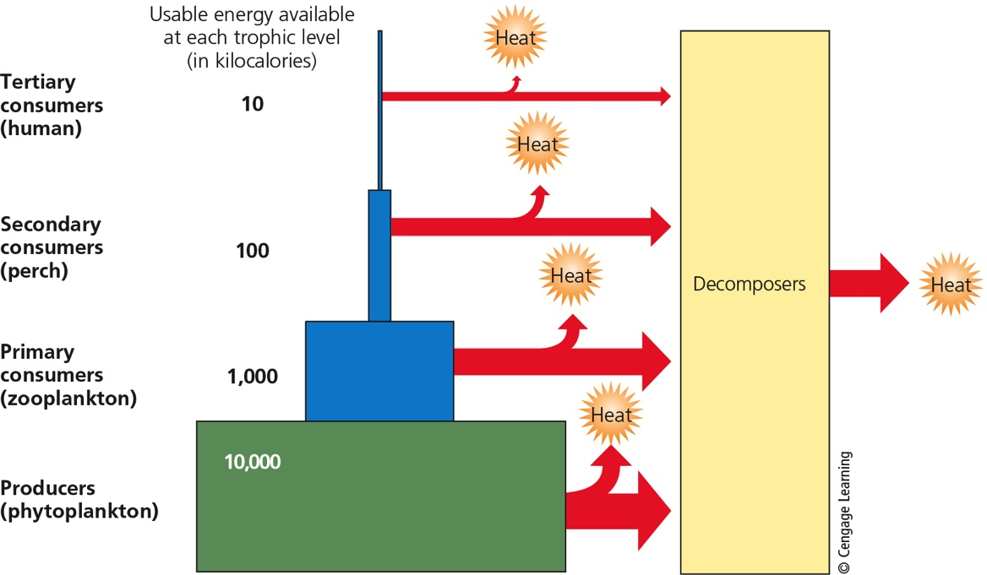
What Happens to Energy in an Ecosystem? (4 of 6)
Notes:
Figure 3.15 Generalized pyramid of energy flow showing the decrease in usable chemical energy available at each succeeding trophic level in a food chain or food web. The model assumes that with each transfer from one trophic level to another, there is a 90% loss of usable energy to the environment in the form of low-quality heat. Calories and joules are used to measure energy. 1 kilocalorie = 1,000 calories = 4,184 joules. Question: Why is a vegetarian diet more energy efficient than a meat-based diet?

Slide 25
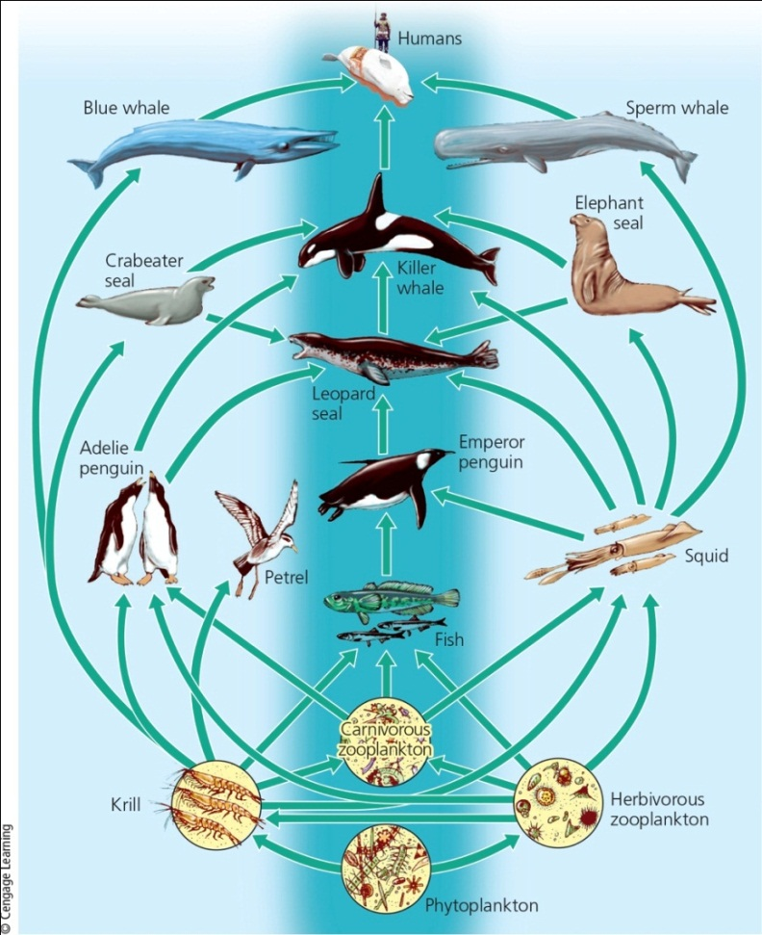
What Happens to Energy in an Ecosystem? (5 of 6)
Notes:
Figure 3.16 A greatly simplified aquatic food web found in the southern hemisphere. The shaded middle area shows a simple food chain that is part of these complex interacting feeding relationships. Many more participants in the web, including an array of decomposer and detritus feeder organisms, are not shown here.

Slide 26
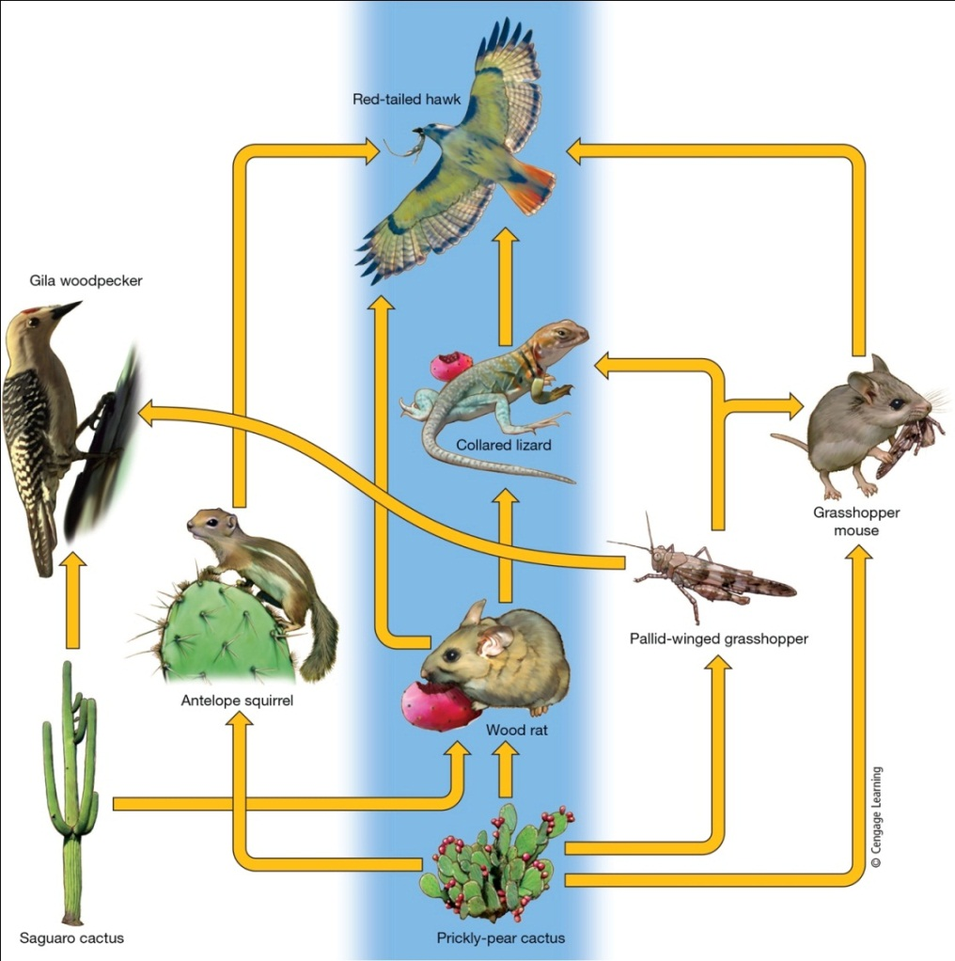
What Happens to Energy in an Ecosystem? (6 of 6)
Notes:
Figure 3.17 Greatly simplified terrestrial food web found in a temperate desert ecosystem. The shaded middle area shows a simple food chain that is part of these complex interacting feeding relationships. Many more participants in the web, including an array of decomposer and detritus feeder organisms, are not shown here. Critical thinking: Can you imagine a food web of which you are a part? Try drawing a simple diagram of it.

Slide 27
Some Ecosystems Produce Plant Matter Faster than Others Do (1 of 3)
Gross primary productivity (GPP)
Rate at which an ecosystem’s producers convert solar energy to stored chemical energy
Measured in units such as kcal/m²/year

Slide 28
Some Ecosystems Produce Plant Matter Faster than Others Do (2 of 3)
Net primary productivity (NPP)
Rate at which an ecosystem’s producers convert solar energy to chemical energy, minus the rate at which they use the stored energy for aerobic respiration
Terrestrial ecosystems and aquatic life zones differ in their NPP
The planet’s NPP ultimately limits the number of consumers (including humans) that can survive on the earth

Slide 29
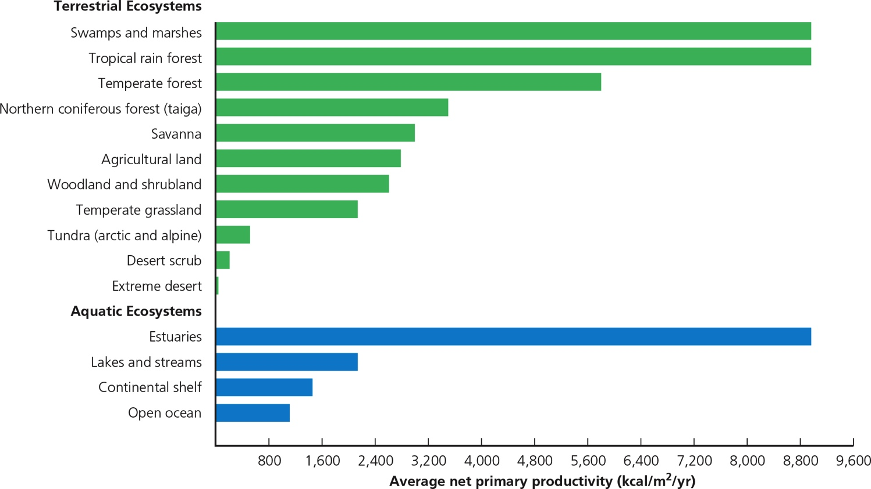
Some Ecosystems Produce Plant Matter Faster than Others Do (3 of 3)
Notes:
Figure 3.18 Estimated annual average net primary productivity in major life zones and ecosystems expressed as kilocalories of energy produced per square meter per year (kcal/m²/yr). Question: What are the three most productive and the three least productive systems?

Slide 30
Critical Concept: What Happens to Energy in a Food Chain?
Ecological Efficiency is the percentage of energy transferred from one trophic level to the next in an ecosystem.
10% rule
Most lost as waste heat
Some energy contained in detritus and metabolic waste provides energy for decomposers and detritivores

Slide 31
3.4 What Happens to Matter in an Ecosystem?
Nutrients cycle within and among ecosystems
Cycles driven by incoming solar energy and gravity
Can be altered by human activity
Cycles
Water, carbon, nitrogen, and phosphorus

Slide 32
Water Cycle Sustains all Life (1 of 3)
Hydrologic cycle collects, purifies, and distributes earth’s fixed supply of water
Incoming solar energy causes evaporation
Gravity draws water back as precipitation
Surface runoff evaporates to complete the cycle
Some precipitation stored as groundwater

Slide 33
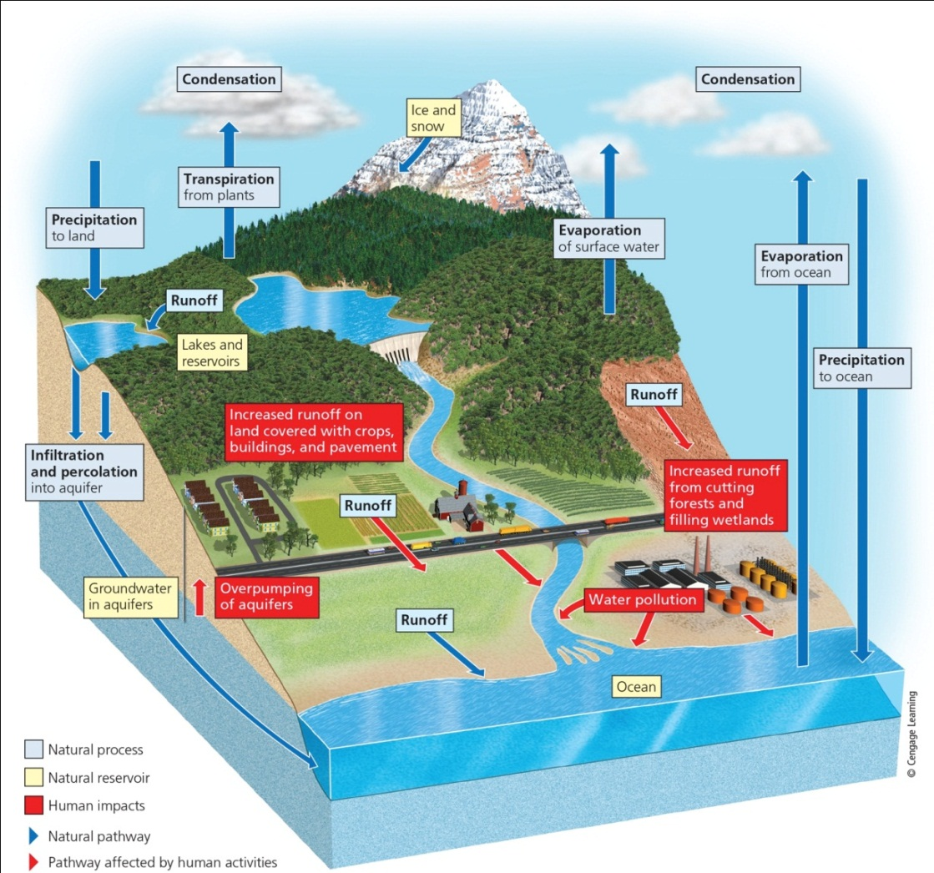
Water Cycle Sustains all Life (2 of 3)
Notes:
Figure 3.19 Natural capital: simplified model of the water cycle, or hydrologic cycle, in which water circulates in various physical forms within the biosphere. The red arrows and boxes identify major effects of human activities on this cycle. Question: What are three ways in which your lifestyle directly or indirectly affects the hydrologic cycle?

Slide 34
Water Cycle Sustains all Life (3 of 3)
Ways humans alter the water cycle
Withdrawing large amounts of freshwater at rates faster than nature can replace it
Clearing vegetation
Increases runoff
Draining and filling wetlands for farming and urban development
Wetlands provide flood control
Absorb and hold overflows of water

Slide 35
Carbon Cycles among Living and Nonliving Things (1 of 2)
Carbon basic building block of carbohydrates, fats, proteins, DNA, and other organic compounds
Photosynthesis from producers removes CO₂ from the atmosphere
Aerobic respiration by producers, consumers, and decomposers adds CO₂
Some CO₂ dissolves in the ocean
Stored in marine sediments

Slide 36
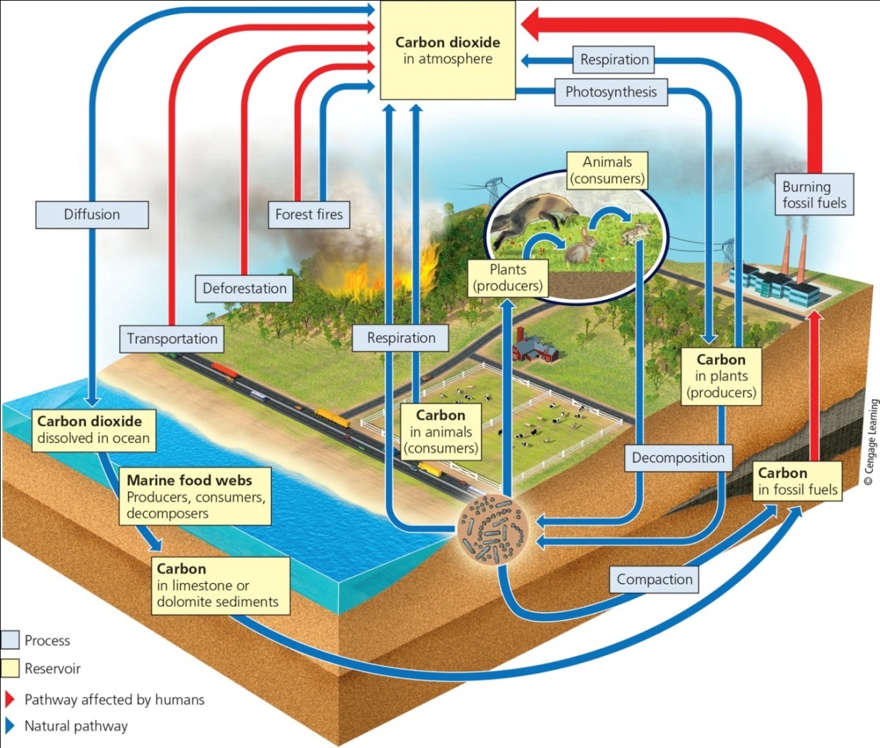
Carbon Cycles among Living and Nonliving Things (2 of 2)
Notes:
Figure 3.20 Natural capital: This simplified model illustrates the circulation of various chemical forms of carbon in the global carbon cycle, with major impacts of human activities shown by the red arrows. (yellow box sizes do not show relative reservoir sizes.) Question: What are three ways in which you directly or indirectly affect the carbon cycle?

Slide 37
Human Disruption of the Carbon Cycle
Humans have added large quantities of CO₂ to the atmosphere
Faster rate than natural processes can remove
Levels have been increasing sharply since about 1960
Result: warming atmosphere and changing climate
Clearing vegetation reduces ability to remove excess CO₂ from the atmosphere

Slide 38
Nitrogen Cycle: Bacteria in Action (1 of 3)
Useful forms of nitrogen
Created by lightning and specialized bacteria in topsoil and bottom sediment of aquatic systems
Used by plants to produce proteins, nucleic acids, and vitamins
Bacteria convert nitrogen compounds back into nitrogen gas

Slide 39
Nitrogen Cycle: Bacteria in Action (2 of 3)
Human alteration of the nitrogen cycle
Burning gasoline and other fuels create nitric oxide, which can return as acid rain
Removing large amounts of nitrogen from the atmosphere to make fertilizers
Adding excess nitrates in aquatic ecosystems
Human nitrogen inputs to the environment have risen sharply and are expected to continue rising

Slide 40
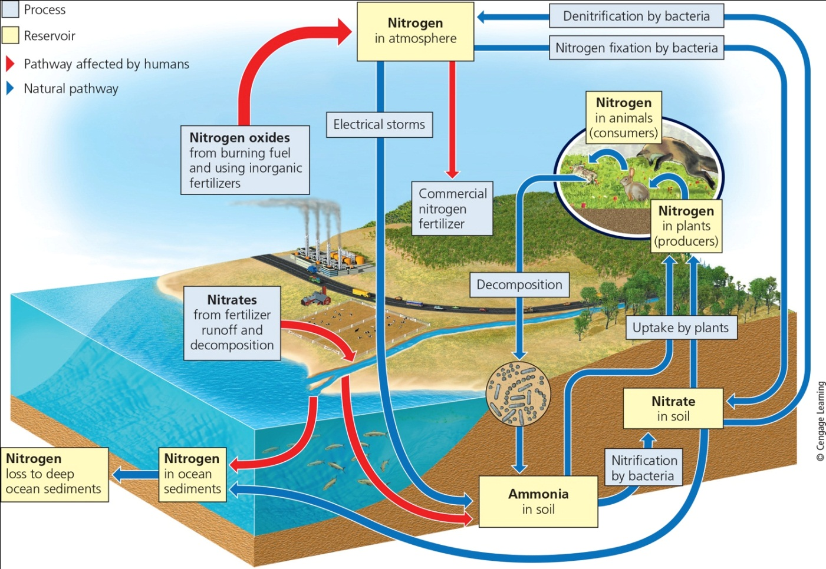
Nitrogen Cycle: Bacteria in Action (3 of 3)
Notes:
Figure 3.21 Natural capital: Simplified model showing the circulation of various chemical forms of nitrogen in the nitrogen cycle, with major human impacts shown by the red arrows. (yellow box sizes do not show relative reservoir sizes.) Critical thinking: What are two ways in which the carbon cycle and the nitrogen cycle are linked?

Slide 41
Phosphorous Cycles through Water, Rock, and Food Webs (1 of 2)
Phosphorus cycles through water, the earth’s crust, and living organisms
Major reservoir is phosphate rocks
Cycles slowly
Human activities and impacts
Clearing forests
Removing large amounts of phosphate from the earth to make fertilizers
Erosion leaches phosphates into streams

Slide 42
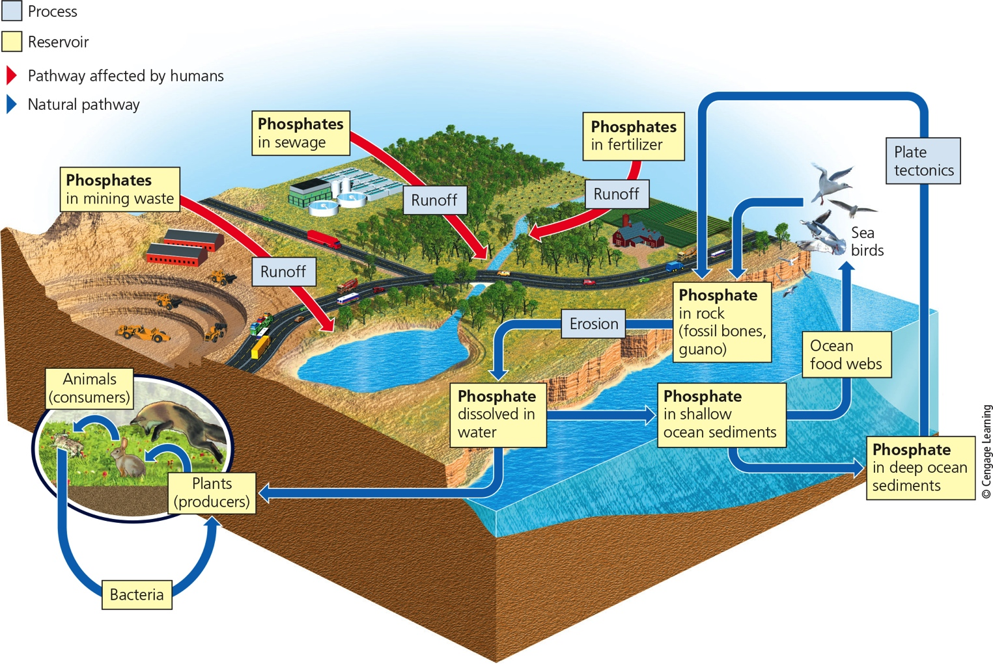
Phosphorous Cycles through Water, Rock, and Food Webs (2 of 2)
Notes:
Figure 3.23 Natural capital: Simplified model showing the circulation of various chemical forms of phosphorus (mostly phosphates) in the phosphorus cycle, with major human impacts shown by the red arrows. (yellow box sizes do not show relative reservoir sizes.) Critical thinking: What are two ways in which the phosphorus cycle and the nitrogen cycle are linked? What are two ways in which the phosphorus cycle and the carbon cycle are linked?

Slide 43
3.5 How Do Scientists Study Ecosystems? (1 of 2)
Methods of study
Field research
Going into forests and natural settings
Laboratory research
Mathematical and other models
Other study tools
Aircraft, satellites, GIS software, GPS systems to track where animals go

Slide 44
Ecologists Do Laboratory Research and Use Models
Model ecosystems and populations under laboratory conditions
Simplified systems with controlled temperature, light, humidity, and other variables
Supported by field research
Mathematical models can simulate ecosystems
Way to study large and complex systems

